Slide 1
Non-discrimination Training for Charter School Boards
Notes:
Welcome to the nondiscrimination training for charter school boards. I encourage you to review this training with your full board and pause for discussions around what is happening and what needs to happen to move the needle for students. Additional resources have been provided for you to engage and to learn more.

Slide 2
The following is provided for informational purposes only and is not be construed as legal advice or formal legal opinion on behalf of the author or CDE
As part of effective governance practices, the Schools of Choice Unit of CDE contracted Education Board Partners to develop a non-discrimination training for charter schools.
Notes:
Please note that the following is provided for informational purposes only. If you have specific legal questions, please refer to your legal counsel.
As part of effective governance practices, the Schools of Choice Unit of the Colorado Department of Education contracted Education Board Partners to develop a non-discrimination training for charter schools.

Slide 3
Charter schools are public schools funded through public dollars and must adhere to national and state anti-discrimination laws.
Notes:
You serve on a charter school board. Congratulations and thank you. Your volunteer service supports high quality education opportunities for families in your community. You are accountable for ensuring the success and sustainability of your school. Though you aren’t involved in the day to day operations of the school, you are accountable for outcomes. Serving on a board is a big job. Nobody goes to school to become a charter school board member. It is OK to ask for resources, help or support if you need it. Throughout this training, you will observe that one of your biggest roles is to ask questions. Reviewing data and asking questions will help you make informed decisions.

Slide 4
Non-discrimination for Governing Boards
1
2
3
Understand the CROWN Act and what it means
Understand the legal and HR definition of Non-discrimination
Recognize appropriate student recruitment, enrollment and discipline policies and practices
4
5
Adapt and apply a racial equity lens to board practices
Comprehend the board’s role in ensuring students with special needs are welcome and the school is compliant
Notes:
This training has five outcomes. First, you will understand the legal and HR definition of non-descrimination. Second you will Understand the Crown act and what it means. Third you will recognize appropriate recruitment, enrollment and discipline policies and practices. Fourth, you will comprehend the board’s role in ensuring students with special needs are welcome and the school is compliant. Last, you will learn how to adapt and apply a racial equity lens to your board practices.

Slide 5
Non-discrimination Definitions

Slide 6
Discrimination
dis·crim·i·na·tion
/dəˌskriməˈnāSH(ə)n/
the unjust or prejudicial treatment of different categories of people or things, especially on the grounds of race, age, gender, or ability.
Notes:
Discrimination is the unjust or predjudicial treatment of different categories of people or things, especially on the grounds of race, age, gender or ability.
Nondiscrimination is the absence or avoidance of discrimination

Slide 7
Charter Schools & Non-discrimination
Charter Schools are subject to all federal and state laws regarding non-discrimination. The Charter School provides evidence of annual training on non-discrimination laws to employees and board members, and otherwise ensures that its board and leadership stay current on all relevant provisions.
1 CCR 301-88
Notes:
Section one of the Colorado Code of Regulations 301-88 is where you will find the information about charter schools and non discrimination.

Slide 8
HR Definition of Non-Discrimination
Colorado follows state anti-discrimination and civil rights laws and guidance. In 2008, Colorado passed a law (S.B. 08-200) expanding prohibitions against discrimination. The law calls out the need to protect all regardless of “disability, race, creed, color, sex, sexual orientation, marital status, national origin, or ancestry” in all places of public accommodation. This law defines sexual orientation as “a person’s orientation toward heterosexuality, homosexuality, bisexuality or transgender status or another person’s perception thereof.”
Notes:
Colorado follows state anti-discrimination and civil rights laws and guidance. In 2008, Colorado passed a law SB 08-200 expanding the prohibitions against discrimination. The law calls out the need to protect all regardless of disability, race, creed, color, sex, sexual orientaion, marital status, national origin or ancesty in all places of public accommodation.

Slide 9
Review Your Data and Policies
 | Policy | Data
Hiring Discipline/Dismissal Promotions | Are your HR policies clear about non-discrimination? | What is the demographic composition of your staff?
 |  | Are there patterns in your staff discipline or dismissal data?
 |  | Which staff members are being promoted?
Notes:
At the board level, your role is to ensure you have appropriate policies and are in compliance with those policies. In order to do that, review your policies regularly and review data connected to those policies. For example, make sure your HR policies are clear about nondiscrimination. Your school may collect data on staff hirings, firings, discipline, dismissal and promotions. You can review this data for patterns to reflect how your policies are working.

Slide 10
CROWN Act
Notes:
The CROWN ACT was enacted in 2020

Slide 11
The CROWN Act
The act enacts the "Creating a Respectful and Open World for Natural Hair Act of 2020", also known as the "CROWN Act of 2020", which specifies that, for purposes of anti-discrimination laws in the context of public education, employment practices, housing, public accommodations, and advertising, protections against discrimination on the basis of one's race include hair texture, hair type, or a protective hairstyle commonly or historically associated with race, such as braids, locs, twists, tight coils or curls, cornrows, Bantu knots, Afros, and headwraps.
Notes:
CROWN stands for Creating a respectful and open world for natural hair. It specifies that for purposes of anti-discirmination laws in the context of public education, protections against discrimination on the basis of one’s race include hair texture, hair type or a protective hairstyle commonly or historically associated with race, such as braids, locs, twists, tight coils or curls, cornrows, Bantu knots, Afros and headwraps.

Slide 12
What It Means For You
Be cognizant of the policies you create and approve and the effect they have on all students and staff.
Ask yourself how your dress code policies affect all students and staff.
The following slide shows examples of schools that put themselves in compromising positions from not understanding the impact of their policies.
Notes:
Be cognizant of the policies you create and approve and the effect they have on all students.
Ask yourself how your dress code policies affect all students.

Slide 13
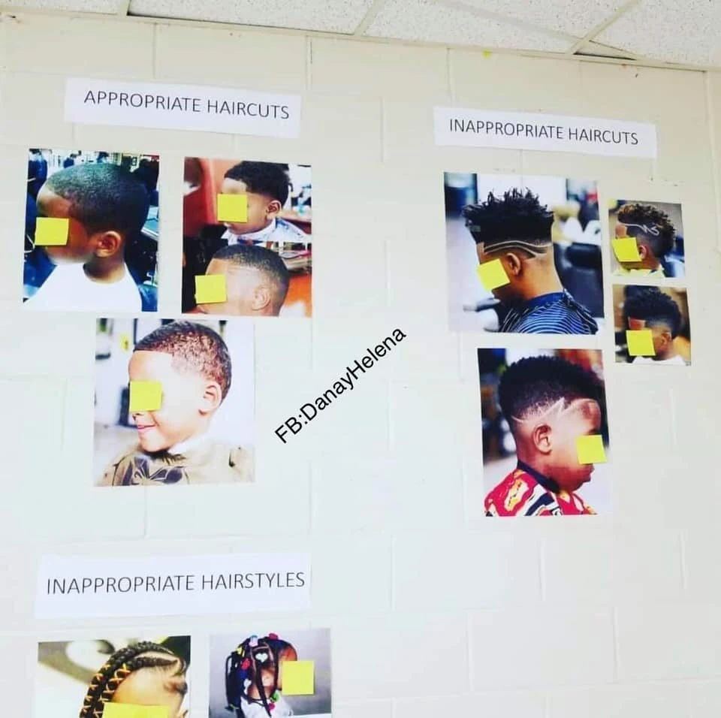
Ripped From the Headlines
Georgia Elementary School Is Accused of Racial Insensitivity Over Hairstyle Guidelines Display
A Fresno honor student got a popular haircut, but school officials didn't like it
A black high school wrestler told by a referee to cut his dreadlocks or forfeit a wrestling match
Black Malden charter students punished for braided hair extensions
Notes:
There have been many examples around the country of student dress codes that prohibit certain hair styles are deemed discriminatory.

Slide 14
Review Your Data and Policies
 | Policy | Data
Dress code | Is your dress code gender and race neutral? | Which students are being called out for dress code violations?
Discipline | Do your dress code policies cause students to be removed from class and hinder equal opportunities to learn? | Which students are missing class time for discipline issues?
Notes:
Again, at the board level, your role is to ensure you have appropriate policies and that they are being followed. You may want to review your dress code policies as well as the consequences of violating those policies. You can ask your school leader to share discipline data with the board to see if there are patterns on which students are being disciplined for dress code violations and you can ask questions about it.

Slide 15
Recruitment, Enrollment, Discipline
Notes:
When it comes to recruitment and enrollment, of course you want to create a welcoming environment for all students.

Slide 16
Student Recruitment and Enrollment
Enrollment in a charter school must be open to any child who resides within the school district; except that no charter school shall be required to make alterations in the structure of the facility used by the charter school or to make alterations to the arrangement or function of rooms within the facility, except as may be required by state or federal law. Enrollment decisions shall be made in a nondiscriminatory manner specified by the charter school applicant in the charter school application.
Notes:
Enrollment in a charter school must be open to any child who resides within the school district. Enrollment decisions shall be made in a nondiscriminatory manner specified in your charter school application.

Slide 17
What It Means For You
Be aware of the recruitment and enrollment decisions in your charter and ensure that they are being adhered to at the school level.
As public schools, charters may not discriminate or inhibit some populations of students from enrolling in the school.
The following slide provides some national headlines that impact negatively on the charter sector as a whole.
Notes:
Be aware of the recruitment and enrollment decisions in your charter and ensure that they are being adhered to at the school level.
As public schools, charters may not discriminate or inhibit some populations of students from enrolling in the school.

Slide 18
Ripped From the Headlines
Tailoring the Charter School Population
Students with behavior problems, low achievement or special needs are sometimes not encouraged to apply to charter schools
When School Choice Means School’s Choice
Parents of students who are “harder to educate” may have a hard time getting schools to reply to their emails about how to apply.
CHARTER SCHOOLS MAY DISCOURAGE APPLICATIONS FROM ‘HARD’ KIDS
Notes:
Across the country, charter schools have made headlines for practices that discourage or inhibit ALL students from enrolling at their schools.

Slide 19
Cannot Limit Enrollment Access
Students with disabilities
Academically low-achieving pupils
English learners
Homeless pupils
Pupils who are economically disadvantaged (determined by eligibility for any free or reduced- price meal program)
Foster youth
Pupils based on nationality, race, ethnicity, or sexual orientation
Notes:
Remember, as a public school you cannot limit enrollment access to students with disabilities, or academically low-achieving pupils, English language learners, students who are homeless or in foster homes. And you cannot limit enrollment based on nationality, race, ethnicity or sexual orientation

Slide 20
Review Your Data and Policies
 | Policy | Data
Recruitment | Do our recruitment policies create any potential barriers that might limit access based on socioeconomic status, language, disability, or culture? | Do we recruit a disproportionately low percentage of these student groups compared to who is in our community?
Enrollment | Do any of our policies or practices seem to limit access to enrollment for any of these groups? | Do we enroll a disproportionately low percentage of these student groups compared to surrounding schools?
Notes:
At the board level, review your recruitment and enrollment policies. Look for possible barriers that limit access based on socioeconomic status, language, ability or culture. Review data to look for patterns of compliance to the policies.

Slide 21
Consider Possible Barriers in Recruitment or Enrollment
What supports are there for families that do not speak English?
How does a family’s access to technology influence the application process?
What information are families required to supply for the application? Are there any questions on the application that could deter particular categories of families, such undocumented or homeless families?
Are families required to visit the school in order to apply?
Are there parent participation requirements, uniform costs, or other school fees required for enrollment that could pose barriers for low-income families?
Does the school participate in the federal free and reduced-price lunch program (or provide a comparable program)?
Does the school provide transportation for enrolled students?
Notes:
Some questions you may want to ask school leadership about recruitment and enrollment are:
What supports are there for families that do not speak English?
How does a family’s access to technology influence the application process?
What information are families required to supply for the application? Are there any questions on the application that could deter particular categories of families, such undocumented or homeless families?
Are families required to visit the school in order to apply?
Are there parent participation requirements, uniform costs, or other school fees required for enrollment that could pose barriers for low-income families?
Does the school participate in the federal free and reduced-price lunch program (or provide a comparable program)?
Does the school provide transportation for enrolled students?
If there are concerns about any answers, have a board discussion to review your policies, processes and procedures to ensure you are not creating unintentional barriers to enrollment

Slide 22
Discipline
Public charter schools have autonomy over their mission and educational model in exchange for increased accountability for student outcomes. They must follow the same rules and regulations that traditional public schools must follow affecting health, safety, and students’ rights, including those that protect students with disabilities. The design and implementation of discipline policies can pose challenges in any public school setting, but in the charter school context, tensions between charter autonomy and public school obligations can raise additional issues.
Notes:
As a Public charter school, you have autonomy over the mission and educational model in exchange for increased accountability for student outcomes. Your school must follow the same rules and regulations that traditional public schools must follow affecting health, safety, and students’ rights, including those that protect students with disabilities. The design and implementation of discipline policies can pose challenges in any public school setting, but in the charter school context, tensions between charter autonomy and public school obligations can raise additional issues.

Slide 23
What It Means For You
Seek to fully understand the discipline policies you create and approve.
Be knowledgeable about the effect the discipline policies at your school have on certain populations.
The following slide shares some examples of how discipline policies may harm certain populations more than others.
Notes:
Seek to fully understand the discipline policies you create and approve.
Be knowledgeable about the effect the discipline policies at your school have on certain populations.

Slide 24
Ripped From the Headlines
Charter Schools Suspend Black and Disabled Students More, Study Says
The Harsh Discipline of No-Excuses Charter Schools: Is It Worth the Promise?
Study Finds Many Charter Schools Feeding "School-to-Prison Pipeline"
Notes:
Discipline policies are another area where discrimination tends to make headlines.

Slide 25
Review Your Discipline Data and Policies
Policy | Data
Does our discipline policy maximize the time students are in school and learning? | Have we looked at disaggregated discipline data by subpopulations?
Do we have a policy on staff discipline training or professional development? | Have we looked for patterns in who submits discipline concerns?
Notes:
Review your policies and data.
Students can’t learn if they are not in class so understand if your discipline policies are taking students out of the learning environment.
First define your subpopulations and then look at discipline data disaggregated by those subpopulations.

Slide 26
Resource
The U.S. Departments of Education and Justice have worked closely with educators through the #RethinkDiscipline campaign to support initiatives that build positive school climates and develop alternative approaches to school discipline. Some guiding principles to know:
Maximize the time students are in school and learning
Cultivate systems that acknowledge and remedy the root causes of students’ and educators’ challenges in school
Leverage data to inform equitable disciplinary systems
Engage the entire school community in professional development and accountability systems that encourage alignment on the school’s intended processes and cultural goals
Notes:
When reviewing your policies and asking questions of your school leader, the US Department or Education and Justice developed some guiding principles to build positive school climates and develop alternative approaches to school discipline.
These include maximizing the time students are in school and learning
Cultivating systems that acknowledge and remedy the root causes of students’ and educators’ challenges in school
Leveraging data to inform equitable disciplinary systems
And engaging the entire school community in professional development and accountability systems that encourage alignment on the school’s intended processes and cultural goals

Slide 27
Students With Special Needs

Slide 28
Serving Students with Special Needs
The Charter Schools Act [C.R.S. 22-30.5-104 (3)] prohibits discrimination on the basis of need for special education services. As a public school, a charter school must comply with the federal Individuals with Disabilities Education Act (IDEA), the Americans with Disabilities Act (ADA), the Office of Civil Rights (OCR) and any state special education laws.
Discipline for students with disabilities must be in accordance with a student’s IEP or 504 and include all the procedural safeguards for students with disabilities mandated by state and federal law.
Notes:
The Charter Schools Act [C.R.S. 22-30.5-104 (3)] prohibits discrimination on the basis of need for special education services. As a public school, a charter school must comply with the federal Individuals with Disabilities Education Act (IDEA), the Americans with Disabilities Act (ADA), the Office of Civil Rights (OCR) and any state special education laws.
Discipline for students with disabilities must be in accordance with a student’s IEP or 504 and include all the procedural safeguards for students with disabilities mandated by state and federal law.

Slide 29
Questions to Ask About Your Students with Special Needs
What is the parent satisfaction level with our special education program?
How are we measuring it?
What percentage of students with IEPs are mastering their IEP goals?
How are we set up to serve all students well (curriculum, teacher quality, behavior supports/expectations, ratios, etc.)?
How does our special education enrollment compare with comparable schools?
How are teachers trained and supported for implementation of special education services?
How does our school performance (and our sped demographics) compare in context of our community?
What does our discipline data for our special needs students look like?
Notes:
Some questions you may want to ask about your students with special needs
What is the parent satisfaction level with our special education program?
How are we measuring it?
What percentage of students with IEPs are mastering their IEP goals?
How are we set up to serve all students well (curriculum, teacher quality, behavior supports/expectations, ratios, etc.)?
How does our special education enrollment compare with comparable schools?
How are teachers trained and supported for implementation of special education services?
How does our school performance (and our sped demographics) compare in context of our community?
What does our discipline data for our special needs students look like?

Slide 30
Governing with an Equity Lens
Notes:
We’ve spent some time talking about nondiscrimination. Now let’s take that and turn it on it’s head. Proponents of charter schools believe that they provide better opportunities for child-centered education and more educational choices for children and families. Education is called the great equalizer, but there has always been inequities in education. We have an opportunity to reimagine education and to put equity at the center. As the board, in the polices, practices, and decisions you make, you sit at the cornerstone of what kids get and what they don’t. Together, we must put intentionality into disrupting systems that have harmed some children for decades.

Slide 31
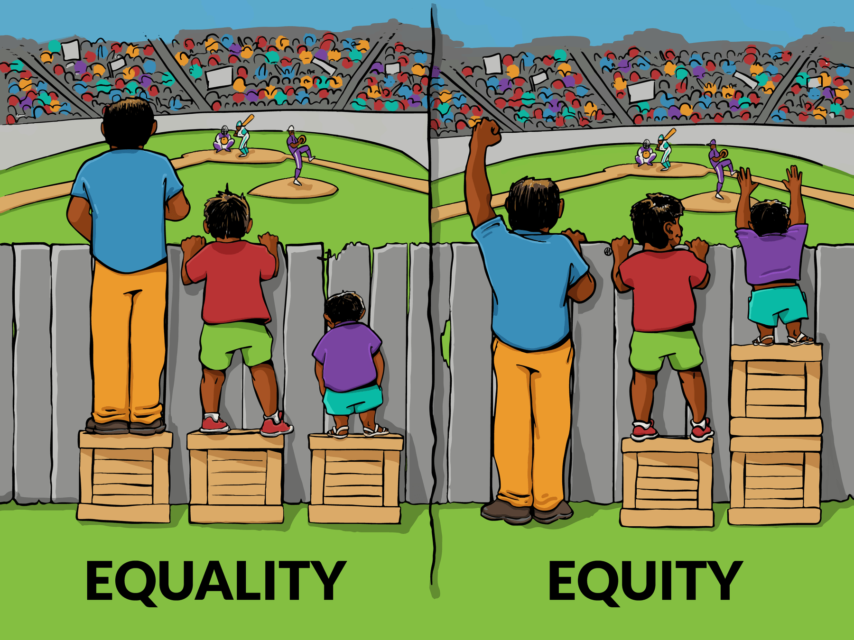
Defining Equity
Notes:
Those of you who engage on social media around equity and or education reform may have seen this image or some version of it before. When we talk about Equality, we talk about everyone getting the same thing. When we talk about Equity, we talk about everyone getting what they need.
What I don’t like about this image is that it insinuates the problem is something inherent in the people who can’t see the game, rather than the systems who are preventing them to see.

Slide 32
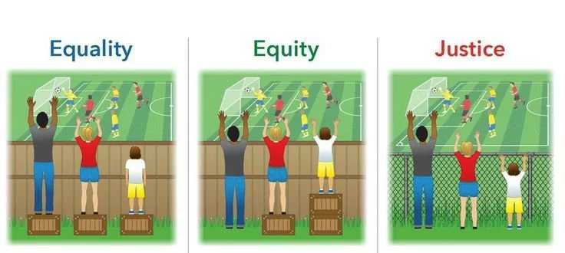
Notes:
What we are really driving towards is tearing down the barriers to great education for all students rather than working hard to make it possible for kids to succeed DESPITE those barriers, which disproportionately affect some kids more than others.

Slide 33
If we declare all students regardless of background should have access to the exact same opportunities that is equality.
Equity is acknowledging students’ differences and giving them what they need to be successful.
Equity focuses on outcomes.
Equity is a commitment to giving every student what he or she needs so they can participate fully in educational opportunities.
The focus of equity work in schools must be to remove the barriers that limit the success for all children.
Notes:
Another way to think about it is
If we declare all students regardless of background should have access to the exact same opportunities that is equality. Equity is acknowledging students’ differences and giving them what they need to be successful. Equity focuses on outcomes. Equity is a commitment to giving every student what he or she needs so they can participate fully in educational opportunities.The focus of equity work in schools must be to remove the barriers that limit the success for ALL children.

Slide 34
Equity Work Starts with Looking in the Mirror
Is our school’s reputation being negatively or positively impacted by our board’s current composition vis-à-vis diversity?
What are we doing/can be done to cultivate a deeper understanding of the community, families and students that we serve and bringing their perspectives, needs, feedback, and priorities into our strategic boardroom discussions?
Are we ever at risk of making decisions without fully understanding how these decisions may affect those we serve? How? In what situations? Examples?
If we were to make a deeper commitment to DEI, specifically equity, what would that mean for our mission, our work, and the students we serve?
Notes:
You may say, what can we as a board do? The first thing is to hold up a mirror and ask yourself a few questions.
Is our school’s reputation being negatively or positively impacted by our board’s current composition vis-à-vis diversity?
What are we doing/can be done to cultivate a deeper understanding of the community, families and students that we serve and bringing their perspectives, needs, feedback, and priorities into our strategic boardroom discussions?
Are we ever at risk of making decisions without fully understanding how these decisions may affect those we serve? How? In what situations? Examples?
If we were to make a deeper commitment to DEI, specifically equity, what would that mean for our mission, our work, and the students we serve?

Slide 35
Goal: Equitable Outcomes for All Students
Think through the following questions:
Who thrives at this school? Who struggles?
Does enrollment in advanced classes represent a diverse body of students?
Are interventions offered for struggling students? If so, are they effective?
Is there evidence of equitable outcomes?
Is there evidence of inequitable outcomes?
Notes:
Again, if the goal is equitable outcomes for all students then your role as a board is to review data and ask questions. Start with:
Who thrives at this school? Who struggles?
Does enrollment in advanced classes represent a diverse body of students?
Are interventions offered for struggling students? If so, are they effective?
Is there evidence of equitable outcomes?
Is there evidence of inequitable outcomes?

Slide 36
Six Steps Toward Governing with Equity
1. Identify your “WHY”
2. Build Awareness
3. Conduct Analysis
4. Take Action
5. Build Accountability
6. Determine Impact
Notes:
Many of your schools engage in equity work, but often it doesn’t rise to the board level.
First, ask your school leader what work is being done around anti-racist policies, culturally relevant curriculum, engaging meaningfully with the community, contracting with minority owned businesses?
When you are ready to dive in to equity work, we suggest these six steps.
Identify your why
Build awareness
Conduct analysis
Take action
Build Accountability
Determine Impact

Slide 37
Identify Your Why
Why does deepening our focus and expertise/competence on equity make sense for us?
Why is now the right time to focus on equity in governance?
How do our mission and values align with equity-focused governance?
What’s happening related to equity in our organization? Region? Nationally?
What can/will sustain the WHY?
Notes:
Many schools put out a Black Lives Matter statement. Did yours? What was that process? How was the board involved in it? How did it connect to your WHY?
Take time with your board and ask:
Why does deepening our focus and expertise/competence on equity make sense for us?
Why is now the right time to focus on equity in governance?
How do our mission and values align with equity-focused governance?
What’s happening related to equity in our organization? Region? Nationally?
What can/will sustain the WHY?

Slide 38
Build Awareness
What vision, goals, effort/initiatives have been identified or undertaken at your school?
What has been the outcomes of DEI efforts?
What do our stakeholders believe? Need? Want?
What does research suggest?
Notes:
Next, Build Awareness
Understand What effort/initiatives have been identified or undertaken at your school?
What has been the outcomes of those efforts?
What do our stakeholders believe? Need? Want?

Slide 39
Conduct Analysis
What do we/others say/think about what’s going on?
How do we/others interpret what’s going on?
Where do you/others think you should be?
What patterns do you see?
What strengths and gaps exist?
What are the highest priorities for the board? Others? Are there conflicts?
Consider drafting a summary of findings, analysis and conclusions.
Notes:
Get the data and analyze it.
What do we/others say/think about what’s going on?
How do we/others interpret what’s going on?
Where do you/others think you should be?
What patterns do you see?
What strengths and gaps exist?
What are the highest priorities for the board? Others? Are there conflicts?
Consider drafting a summary of findings, analysis and conclusions.

Slide 40
Take Action
Engage multiple stakeholders to craft an equity vision.
Given the vision-where you want to be, identify your priorities?
What potential courses of action exist to achieve your vision?
Develop and implement your plan to eliminate inequity in your school/board.
The plan should include metrics, indicators and deadlines
Engage diverse stakeholders in audit of programs/services, quality of faculty/staff
Share progress with stakeholders and standardize opportunities to gather stakeholder feedback regularly
Notes:
Take action
Start by crafting an equity vision AND engaging stakeholders in that effort
Then identify your priorities
Determine your courses of action to achieve your vision.
Develop and implement your plan
Treat it like other goals- have metrics, indicators, deadlines
Conduct and audit
Share progress with stakeholders and get their feedback

Slide 41
Build Accountability
What structures, practices, procedures/processes can sustain your commitment to equity, eliminate inequity.
Plan and fund ongoing learning and development in DEI skills and competencies throughout the board and org.
Engage diverse stakeholders in analysis of plan, strategies and impact.
Share progress with stakeholders and standardize opportunities to gather stakeholder feedback regularly
Notes:
Build accountability
To sustain your commitment, make sure you put structures, practices and processes in place.
Put funds toward ongoing learning and development
Engage stakeholders
And share your progress

Slide 42
Determine Impact
What was the impact of our actions/decisions? Was this our intention?
What was the impact and experience for various stakeholders?
Did our plan create unintended impacts (+/-) for any stakeholder(s)?
What did we learn?
What will we do differently?
Notes:
Last, reflect on the impact. Did your efforts reach the intended impact?
Did the plan create any unintended impacts for stakeholders?
What did you learn?
What will you do differently?
Continue on your journey. Equity work isn’t a one time project. Until we all accept responsibility for the things we control- for the board that means the conditions within your school- we can’t and won’t make the needed change in education.

Slide 43
Training Designed by Education Board Partners
Education Board Partners is a national nonprofit whose mission is to ensure that the nonprofit boards governing public charter schools, autonomous public schools, and education ecosystem organizations are actively and successfully working to improve quality, equity, and accountability in public education, so that all students have access to a great public school.
Find additional resources and services at:
www.edboards.org
www.facebook.com/EducationBoardPartners/
@educationboards
www.linkedin.com/company/education-board-partners/
Notes:
Education Board Partners designed this training. We are a national nonprofit whose mission is to ensure that the nonprofit boards governing public charter schools are actively and successfully working to improve quality, equity and accountability in public education so that all students have access to a great public school. To learn more about our work and supports we provide to boards, please visit us at www.edboards.org

Slide 44
Resources
1 Colo. Code Regs. § 301-88-2.02
Colorado CROWN Act
Colorado Charter Schools Act
Rethinking School Discipline
Schools of Choice Equity Convening Toolkit
National Center for Special Education in Charter Schools
BoardSource: Taking Action on Board Diversity
EBPs Six Steps Towards Governing with Equity

