Slide 1
Colorado Authorizer Bootcamp
Welcome & Overview
Notes:
50-minute session
Welcome and overview of Bootcamp
•Alex: Framing & Welcome (3mn)
•Robin: Additional framing (2mn), start introductions of WestEd team (30 seconds each)
•Kelly: Talk through getting settled, logistics, resource folder, quick whip around of name/district (5mn)
(CHAT: Introduce yourself in the chat! What is your name, what district/authorizer you represent, and how many years have you been in authorizing work?)

Slide 2
Today’s Agenda
Wednesday, November 3rd
12:00 – 12:05 p.m. – Welcome and Overview
12:05 – 12:50 p.m. – Colorado Charter Law and Statutory Requirements
12:50 – 1:00 p.m. – Break
1:00-1:30 p.m. – Mission and Vision for Authorizing
1:30 – 2:00 p.m. – Colorado Principles and Standards for Authorizing
Notes:
Discuss agenda for day
(CHAT: Here is a link to all resources that will be used today)

Slide 3
Colorado Charter Law & Statutory Requirements
Colorado Authorizer Bootcamp
Notes:
Welcome and overview of Bootcamp

Slide 4
Bootcamp Norms
Remember to mute yourself
Utilize the chat for questions and comments
Respond to the survey
Notes:
Before we dive into Bootcamp, let’s go over some quick norms. By now I bet you’re all zoom experts, but as a reminder:
1 - Remember to mute yourself when you’re not speaking
2 – Utilize the chatbox for any questions or comments that come up during any presentation today. We will have time for questions at the end of every session, but as questions come up feel free to drop them in the chat. We will try our best to answer all questions during the presentation, but if we don’t get to them CACSA will be sure to note them and follow up.
3 – Please respond to the survey that we will be sending out at the end of each day of Bootcamp. Your feedback will help to ensure this Bootcamp is successful and helps to improve your own practice in authorizing.

Slide 5
Bootcamp Engagement
We want you to be an active participant!
Chat Question
Poll Question
Group Discussion
Authorizer Example
Notes:
This Bootcamp is going to cover a lot of information, and we want you to be involved in every session as an active participant. You’ll see these icons on slides where we have ways for you to engage, whether that is through a poll question, chat question, small group discussion in a breakout room, or by listening to an established Colorado authorizer.
We encourage you to keep your cameras on and be an active participant in today’s sessions.

Slide 6
Session Agenda
Brief History of Charters in Colorado
Colorado Charter Law
State Accountability System
Other Federal and State Laws
Notes:
Discuss agenda
This session is intended to be an overview of charter law in Colorado; however, we will not cover everything in statute. Of the statute covered on this slide, we will look at the main areas of authorizing and what law applies to each topic.

Slide 7
Objectives
Authorizers will review a brief history of chartering in Colorado.
Authorizers will review statutory requirements for authorizing a charter school in Colorado.
Authorizers will begin to understand implications for authorizing a charter school in Colorado.
Notes:
Review objectives
Again – this is intended to be a brief review to help you begin your understanding of charter law. We hope this will help you understand what statute to go back to when referencing your decision-making processes, etc.

Slide 8
History of Charter Law in Colorado
1988
“Idea model” for charter schools created
1993
Colorado charter law passed
First charter law passed in MN
2004
The Colorado Charter School Institute (CSI) is created
1991
2009
Education Account-ability Act Passed
Ongoing
READ Act
Full Day K
BEST Grant Program
Notes:
Review major dates in the history of chartering.
1988: This is the year that the ”idea model” for charter schools is credited. An education reformer and American Federation of Teachers president named Albert Shanker proposed a new kind of public school called a charter school which would allow teachers to experiment with new approaches to learning.
1993: The first state in the nation to pass a charter law occurred in 1991 in Minnesota. From there, many states moved in the same direction, including Colorado.
1993: CO Charter Law Passed: On June 3, 1993, the Colorado State General Assembly approved the Charter School Act (“CSA”). This law was intended—in part—to “create schools with high, rigorous standards for student performance to improve student learning; to increase learning opportunities for all pupils, with special emphasis on expanded learning experiences for pupils who are identified as academically low-achieving; and encourage diverse approaches to learning and education.”
2004: CSI Created: In 2004, the legislature created the Colorado Charter School Institute (CSI) to “provide an alternative mode of authorizing charter schools as a means to assist school districts in utilizing best practices for chartering schools and to approve and oversee charter schools in school districts not desiring to do so themselves.” As part of this legislative revision, school districts were allowed to request an “exclusive chartering authority” status, which would mean that any charter school seeking to operate a school in their district would have to first apply to the school district for consideration. Exclusive Chartering Authority is a status granted to school districts when the school district commits to providing fair and equitable treatment to its charter schools. In Colorado, most school districts have sought Exclusive Chartering Authority status, and most have retained this status. In general, charters are authorized by their district. Currently, CSI authorizes 42 of 260 charter schools.
2009: The Education Accountability Act of 2009 authorized the Colorado Department of Education to conduct annual performance reviews of all public schools and districts and make recommendations to the State Board on (1) improvement plans for schools, and (2) accreditation categories for districts. In response, CDE introduced the Unified Improvement Planning system to streamline and standardize the improvement planning process and meet both state and federal requirements.
Since then: Since 2009 there have been multiple legislation changes that have also impacted charters in Colorado, including the passage of the READ Act to accelerate the number of children reading at grade level by the end of third grade, the BEST Grant program to provide funding for construction and renovations of facilities, and legislation regarding full day kindergarten.
*This Bootcamp and following sessions are geared towards district authorizers

Slide 9
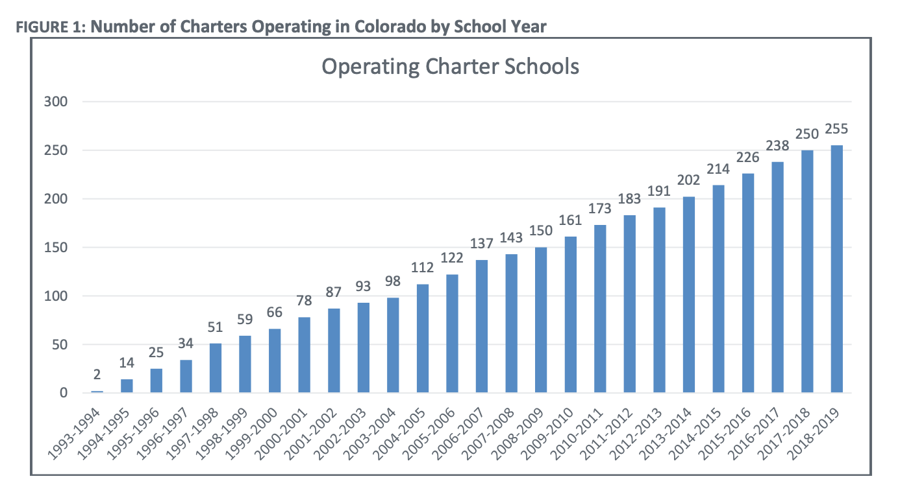
Growth of Charter Schools in Colorado
Source: CDE 2019 Triennial Report
Notes:
Here is a look at the growth of the charter sector in Colorado from 1993 (the first-year charter law was passed) to 2019.
(CHAT: What do you notice regarding this growth? What surprises you?)
Source: CDE 2019 Triennial Report
https://www.cde.state.co.us/cdechart/2019charterschooltriennialreport

Slide 10
Enrollment of Students in Charter Schools
Source: https://nces.ed.gov/fastfacts/display.asp?id=30
Notes:
It may also be helpful to see how Colorado compares to other states in the nation when it comes to the total enrollment of students in the charter sector. Based on 2017 enrollment data, Colorado has roughly 13% of the total student population enrolled in public charter schools, which puts it at the higher end compared to other states. As of 2019, this rate was at 13.5% based on the CDE 2019 Triennial Report.
(CHAT: What stands out to you about the enrollment of students in Colorado charters compared to other states?)
Source: https://nces.ed.gov/fastfacts/display.asp?id=30

Slide 11
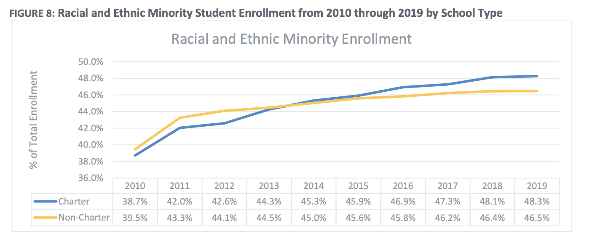
Racial & Ethnic Minority Enrollment
Source: CDE 2019 Triennial Report
Notes:
It is also interesting to look at the enrollment of students in the charter sector in Colorado based on racial and ethnic minority enrollment. This graph here shows the blue line, which is the charter sector, has increased the percentage of racial and ethnic minorities from 2010 to 2019, even more so than the traditional public-school sector.
Source: CDE 2019 Triennial Report
https://www.cde.state.co.us/cdechart/2019charterschooltriennialreport

Slide 12
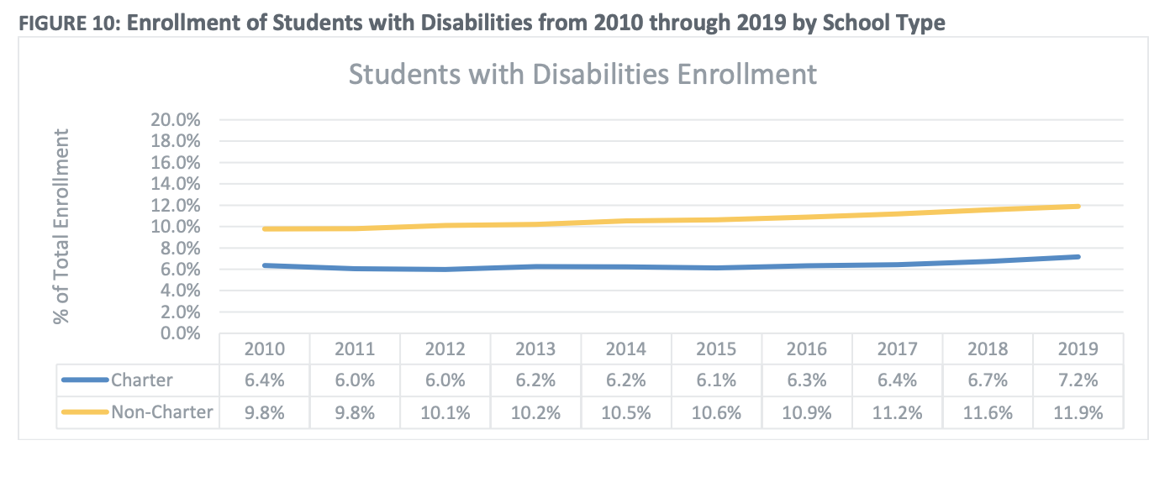
Enrollment of Students with Disabilities
Source: CDE 2019 Triennial Report
Notes:
Let’s also take a look at the enrollment of students with disabilities in the charter sector in Colorado. This graph here compares the charter sector, represented by the blue line, to traditional public schools, represented by the orange line. In 2010, charters enrolled 6.4% students with identified disabilities, compared to 7.2% in 2019. This is a slightly lower increase compared to non-charters, who have gone from enrolling 9.8% students with disabilities in 2010 to 11.9% in 2019. This gap in Colorado between enrollment of students with disabilities in charters is the lowest in the nation, and the gap between traditional public schools and charters is among the bottom three biggest gaps in the nation.
Source: CDE 2019 Triennial Report
https://www.cde.state.co.us/cdechart/2019charterschooltriennialreport

Slide 13
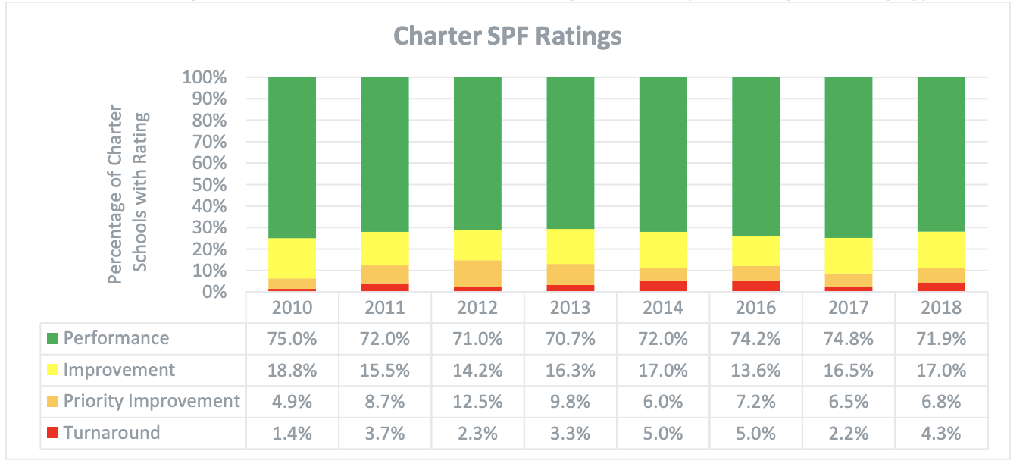
Performance of Colorado Charter Schools
Source: CDE 2019 Triennial Report
Notes:
Finally, this shows the academic performance of charter schools in Colorado, based on the state’s school performance framework. In 2018, about 72% of all charter schools earned the highest ranking on the SPF, which is performance. About 4% were in the bottom bracket of the SPF, turnaround. When looking at all schools in Colorado, 69% of schools earned the highest rating of performance in 2018-19.
Source: CDE 2019 Triennial Report
https://www.cde.state.co.us/cdechart/2019charterschooltriennialreport

Slide 14
Terms & Acronyms
CDE
Colorado Department of Education
CSI
Colorado Charter School Institute, the state authorizer
SPF
School Performance Framework
UIP
Unified Improvement Plan
Notes:
A full list of terms and acronyms that we will use throughout Bootcamp is provided in a handout, however, here is a list of some common terms we will be using in this presentation.

Slide 15
Colorado Charter Law
A closer look at charter statute in Colorado that impacts authorizing.
Notes:
Within this section, we will take a closer look at statute in Colorado that impacts authorizing work. For each of these main topics covered, we will go into detail later in Bootcamp and provide more information as well as additional resources.

Slide 16
What do you already know about charter law in Colorado?
True or False?
There is a cap on the number of charter schools allowed to open in the state of Colorado.
Districts never allow a charter applicant to apply to CSI when they have exclusive chartering authority.
Charter schools in Colorado are funded in the same manner as traditional public schools.
Notes:
Let’s start by looking at a few questions to see what you already know about Colorado charter law. We’ll revisit this again at the end of the presentation and reveal all answers.
I’ll now turn it over to my colleague Lauren, who will walk us through sections of statute.
(LAUNCH POLL)

Slide 17
Overview of Colorado Charter Schools Act (1)
Purpose of charter schools:
To improve pupil learning by creating schools with rigorous standards for pupil performance
To increase learning opportunities for all pupils, with special emphasis on expanded learning experiences for pupils who are identified as academically low achieving
To encourage diverse approaches to education and the use of innovative, research-based, or proven teaching methods
Title 22 Article 30.5 Part 1
22-30.5-120
Notes:
Topic: Colorado Charter Schools Act
Today we are going to start by looking at the Colorado Charters Schools Act, which is Article 30.5 of Title 22. As an authorizer, the Charter Schools Act contains detailed information to guide you in your work. We’ve organized this presentation by looking at some of the main topics of authorizing and looking at what it states in statute for each of these topics. This presentation should help to serve as a reference for you to go back to, but by no means do we intend for you to memorize everything we go over today.
For some background, the Colorado Charter Schools Act is what has established charter schools in the state.
In Colorado, the purpose of charter schools is to improve pupil learning by creating high-performing schools that will specifically serve students who have been identified as academically low achieving.
The intent of the law states that charters should encourage diverse approaches to learning and be incubators of trying new and innovative ideas in education.

Slide 18
Overview of Colorado Charter Schools Act (2)
Purpose of charter schools:
To promote longitudinal analysis of student progress
To create new employment options and professional development for teachers and principals
To provide parents and students with expanded choice and promote community involvement and an avenue for participation in education process
To hold charters accountable for performance
Title 22 Article 30.5 Part 1
22-30.5-120
Notes:
In addition, the laws states that the purpose of charter schools is to—
promote the longitudinal analysis of student progress,
create new employment options,
provide parents and students with expanded choice, and
hold charters accountable for performance.

Slide 19
Authorizing Charter Schools in Colorado
Who can authorize a school in Colorado?
A school district
Charter School Institute – the statewide charter school authorizer
An applicant cannot apply to a district unless a majority of the proposed students reside in the chartering district or contiguous districts.
C.R.S. § 22-30.5-120
Notes:
Topic: Application Review Process
This Bootcamp is focused on going over legal requirements as well as best practices when it comes to authorizing charter schools in Colorado.
It’s important to note that in Colorado, either a district or the Charter School Institute (CSI) can authorize charter schools.
We will talk a bit more later in the session about why a district or a school would want to be authorized by CSI, however, this session focuses on the legal requirements for district authorizers.
We will continue to point out some differences between district authorizers and CSI, and will be using many of their materials, as they are one of the models of what it means to be a high-quality authorizer in Colorado.

Slide 20
Application
C.R.S § 22-30.5-106
C.R.S § 22-30.5-107
State statute requires specific information be included in the charter application
Timeline
Districts establish a date for submissions between August 1 and October 1, unless a waiver is granted
Completeness Review
Initial review for compliance must be completed within 15 days of submission and applicant has 15 days for correction
Final Vote
Local board must vote on application within 90 days of submission
No application fee may be charged by authorizers
Many authorizers operate on an 18-month application timeline, based on waiver approved
Notes:
Topic 1: Charter Application
Let’s begin by looking at what the law states around the charter application process. Statute includes a list of information that must be included in the charter application for every district or state authorizer. Items such as asking an applicant to state their mission and vision of the school, the goals around student academic performance, description of their academic program and operational plan, as well as plans for community involvement must be asked. There is also a requirement that schools speak to their plans for how they will service students with special needs.
CACSA has created a model application based on these requirements, which we will look at in detail in an upcoming session of Bootcamp.
The Colorado law also includes information on the submission process for charter applications. In general, the law states that a timeline must be established by the authorizer that includes a deadline for applications that is sometime between August 1st and October 1st.
Once an application is received, authorizers have 15 days to review the application to see if it meets the minimum requirements. If the application has missing information, applicants then have another 15 days to make any corrections before it is reviewed. An application then goes through a formal review process, which we will talk about on the next slide before it goes to a final vote with the local district board. This vote must occur within 90 days of application submission. An authorizer is not allowed to charge an application fee during this process.
(POLL: Based on your knowledge, does your district have an 18-month waiver for the application process? (Yes/No))

Slide 21
Application Review: Approval or Denial
C.R.S § 22-30.5-107
State Board policy requires authorizers conduct a rigorous review of each application
Statute includes minimum requirements, but no specific application approval criteria
District authorizers must have their district accountability committee (DAC) review applications
Community meeting must be held with public notice
Local board must make approval or denial decision in a public meeting
Once approved, all negotiations must be agreed upon no later than 90 days after local board vote
District school board must notify CDE of any denied application within 15 days of denial
Notes:
Topic: Denials and Appeals
Let’s look at what occurs during this 90-day review period. Law states that authorizers must conduct a rigorous review of each application and does include a list of minimum requirements for all applications, which we looked at on the application slide. However, there are no specific approval criteria listed in law.
Within the review process, there is a requirement that all applications are reviewed by the District Accountability Committee (or DAC).
This committee needs to be made up of at least one parent or guardian who has a child that attends a charter school as well as an individual that has knowledge or a background in charter schools.
Many authorizers will also conduct an interview with each applicant before this hearing, which you will hear referenced as a capacity interview, although this is not a requirement in law.
After the DAC reviews the application and the authorizer has formed a recommendation on the application, a public hearing must be held where a denial or approval decision is made. Any denial reasons must be in writing.
If an application is approved, the next step in the process is creating a contract, or charter. The school’s contract must be agreed upon no later than 90 days after the local board vote.
The law does not cap charter school growth, meaning an application cannot be denied based on the number of charters already in existence.

Slide 22
Appeals
C.R.S § 22-30.5-108
Applicants may appeal denials to the State Board
Applicant has 30 days from notice of denial to appeal
State Board then reviews appeal and accepts local board decisions or sends back to local board to reconsider within 60 days
Local board then reconsiders and votes to uphold denial, or reverse to an approval
If still denied, applicant may go back to State Board. State board decision to approve or deny is then final decision.
Notes:
Topic: Appeals
Statute outlines specific timelines for the appeals process.
If an application is denied, this information must be given to CDE within 15 days of the denial.
Applicants have the right to appeal any denial decision to the State Board of Education.

Slide 23
Charter Contract
C.R.S § 22-30.5-105
Approved applications are the basis for contract
Terms of charter contracts for new schools must be at least 4 years for district authorizers. Best practice is to grant initial contract for no more than 5 years.
A list of automatic waivers from state statute should be included in contract
Contract should also include information on whether the district will support start-up facility needs and long-term facility needs
Notes:
Topic: Charter Contract
As we stated, all approved applications must then have a contract completed within 90 days of the approval.
The original application submitted to the authorizer must be the basis for this contract.
The law requires that new charter contracts must be for terms that are at least 4 years for district authorizers.
This contract also includes a list of automatic waivers to the state statute that are written into law and should include any additional waivers that will be requested to CDE.
(POLL: Is the following included as an automatic waiver to statute for charters in Colorado? 22-32-126, C.R.S. Employment and authority of principals (Yes/No)

Slide 24
Ongoing Oversight & Evaluation
C.R.S § 22-30.5-110
Law requires authorizers to annually review a school’s performance and provide written feedback to the school
Review progress in meeting objectives
Review financial audit
Information from annual reviews must be taken into account in the renewal process
If school is on state accountability clock
School must present a summary of changes to improve performance and progress made to authorizer
Notes:
Topic: Ongoing Oversight & Evaluation
Authorizers are legally required to annually review all charter schools in their portfolio and provide feedback to the school based on this review.
This review must include looking at the school’s progress in meeting the objectives set out in their charter contract as well as reviewing the most recent financial audit.
Additionally, information that is gathered in these annual reviews must be used in the renewal process when the school’s contract is at its term.
There are further oversight requirements if a charter is on the state’s accountability clock, which we will discuss in more detail later.
If a school has been identified by the state’s accountability system as low-performing, the school must present a summary of the changes they are making to improve student performance as well as any progress made and present this to their authorizer.

Slide 25
Renewal
C.R.S § 22-30.5-110
Schools submit a renewal application no later than December 1 of the year prior to the year in which the charter expires
Each district must adopt procedures and timelines for the renewal process
Annual reports on the performance of schools must be used in renewal decisions
The local board must rule on renewal decisions no later than February 1 of the year the charter expires
Notes:
Topic: Renewal
As we stated earlier, initial charter contracts must be for a period of at least four years. The law requires that a renewal application must be submitted by the school no later than December 1st of the year prior to the year in which the charter expires. Each authorizer must have a specific process for renewal with deadlines set that are shared with all schools in their portfolio.
When making renewal decisions, the annual reports conducted must be included as part of the body of evidence used.
The law also states that the renewal application must include information on the progress the school has made in achieving their goals and objectives in their charter contract as well as financial information that gives the authorizer enough information to compare the costs of the school to other organizations.
Once information is gathered, the chartering board then must rule on renewal decisions no later than February 1st of the year the charter expires.
We will go into detail on the renewal process later in Bootcamp as well.

Slide 26
Nonrenewal & Termination
C.R.S § 22-30.5-110
Law states general grounds for non-renewal:
Material violation of any condition, standards, or procedures in contract
Failure to make adequate progress toward goals, objectives, content standards, pupil performance standards
Failure to meet generally accepted fiscal management standards
Violation of any provisions of law
Insufficient improvement efforts if in third year of turnaround plan
Authorizing staff makes a recommendation to the local board, who decide to renew or revoke a charter
A charter school may appeal the decision to revoke or non-renew the charter to the State Board
Authorizers must adopt procedures for closing a charter
Notes:
Topic: Nonrenewal and Termination
The law includes general grounds for non-renewal of a charter contract.
These reasons include if the school has violated any conditions, standards, or procedures in the contract, if the school has failed to make adequate progress towards their goals or federal requirements, if the school has failed to meet fiscal management standards, if the school has violated any provision of law, or if the school is on the state’s accountability clock for the third year and has not made significant progress.
If a contract is not renewed, the school has the right to appeal to the State Board.
Authorizers must also have clear procedures in place for what happens when a school is closed, including a plan for how students will enroll in other schools.

Slide 27
District Policy
Most districts in Colorado have a specific district policy, built upon what is in Colorado law.
Do you have an established district charter policy?
How does your district policy relate to Colorado charter law?
How does district policy impact your work?
Notes:
Finally, it’s important to note that most districts in the state have specific district policy when it comes to authorizing charter schools. These policies should include all state and federal requirements and should likely be your go-to documentation to reference in your work. We’re going to jump into some small groups to discuss how district policy may impact your work.
(Small Group Discussion)
7mn
Facilitators:
Quick Group Introductions (name/district/years of experience)– 2 minutes
Discussion Questions: - 5 minutes
How does your district policy impact your work?
Do you know if your district has an established policy document?
If not, why might this be useful? Why would district policy be needed on top of state statute?

Slide 28
Finances
C.R.S § 22-30.5-112
Public School Finance Act of 1994 (C.R.S. Article 54 of Title 22)
Formula used to determine state and local funding amounts for the state’s 178 districts and CSI
Part of funding is from property taxes, which varies widely among districts
Differences in tax bases result in differences in revenues collected
A charter school is responsible for its own operation, including preparation of a budget
School and district agree on funding and any services provided to the school from the district
A charter school shall not be required to pay rent for a space that is available within the district
Charters must comply with all state financial and budget rules, including completing an annual audit
Notes:
Topic: Finances
Charter schools in Colorado are funded similarly to traditional public schools based on the Public School Finance Act of 1994.
Within this act a formula was created to determine funding amounts for all 178 school districts in the state as well as CSI.
The funding for each district varies widely, largely due to differences in tax bases in revenues collected using mill levies.
While we won’t go into too much detail on charter school funding in this session, we do note that charter schools do not always collect funds from mill levies in some districts. This results in inequitable funding for charter schools.
Charter schools must comply with all state financial and budget rules and needs to complete an annual audit.
A charter is responsible for operating and preparing its own budget.
As authorizers, you should make sure to include information in a charter school’s contract that specifies which services may be provided and charged for by the district, as well as include details regarding facilities

Slide 29
Equity & Access
C.R.S § 22-30.5-110
C.R.S § 22-30.5-112.5
1 CCR 301-88 2.02(c)
Transportation Plans
Charters may work with the district in developing a transportation plan
Serving Students
Charter schools must provide access to appropriate services for students with disabilities and assurance that services are delivered in compliance with federal and state law
Charter schools must provide access to services and appropriate services for special populations of students including ELLs, homeless students and gifted students
Enrollment
Schools must adopt enrollment practices that are non-discriminatory
Schools must not create barriers to enrollment such as prior academic performance, special education status, or parent involvement
Notes:
Topic: Equity & Access
There are many aspects of Colorado Charter Law that speak to equity and access. First, there is a specific section of the law that states that charters may work with the district to develop a transportation plan. Charters are not required to offer transportation to students; however, many do to ensure it is not a barrier to enrollment for students.
The law requires charter schools to provide access to services for students with disabilities that are required by state and federal law.
This is also true for serving other special populations such as English learners, homeless students, and gifted students.
Finally, charter schools must ensure that their enrollment practices are non-discriminatory and do not create any undue barriers for enrollment such as requiring testing for admission, asking about special education status, or requiring parent involvement.

Slide 30
Other Areas of Law Impacting Authorizing
Notes:
We’ve discussed areas of the Colorado Charter Schools Act that impact the authorizer, however there are additional state and federal laws that are also crucial to your authorizing work.

Slide 31
Students with Disabilities and English Learners
Individuals with Disabilities Education Act (IDEA)
Federal law that ensures a free appropriate education (FAPE) to eligible children with disabilities and ensures special education and related services are provided to those children
Section 504 of the Rehabilitation Act of 1973 (Section 504)
Federal civil rights law that prohibits recipients of federal funding from discriminating against individuals with disabilities
Title III
Supplemental grant under ESEA designed to improve and enhance the education of English learners in becoming proficient in English and meeting the Colorado Academic standards
Exceptional Children’s Education Act (ECEA)
Colorado has outlined specific requirements regarding IDEA implementation for the state
Notes:
Topic: SWD & ELL
There are several federal and state laws pertaining to the rights of students with disabilities and English learners.
Federal requirements
Specifically, all schools, including charters must comply with the Individuals with Disabilities Act (IDEA) and Section 504 which speak to ensuring students with disabilities have access to a free appropriate education and services are provided to all children.
ESSA, Title III is another federal grant program designed to improve the education of English learners.
State requirements
The Exceptional Children’s Education Act (ECEA) outlines Colorado’s requirements regarding IDEA and how it is implemented.
All schools are required to follow any state and federal requirements for serving these student populations.
We will discuss this in more detail during our compliance session and in the Bootcamp sessions regarding TA .

Slide 32
Code of Colorado Regulations
There are a variety of regulations that impact authorizing:
1 CCR 301-1: Administration of Statewide Accountability for Colorado Public School System, Charter School Institute, Public School Districts and Public Schools
1 CCR 301-88: Standards for Charter Schools and Charter School Authorizers
1 CCR 301-91: Rules Concerning Charter Schools Applying for Federal and State Grants and Programs
1 CCR 301-82: Rules for the Authorization of Charter Schools and Charter School Collaboratives as School Food Authorities
Notes:
Topic: Code of CO Regulations
We’ve referenced the Code of Colorado Regulations throughout the first part of this session, which are rules, policies and regulations adopted by the State Board of Education.
The State Board of Education is charged with the supervision of public schools in the state, giving them the power to promulgate rules with the force of law.
Some of these regulations are included in the topics we previously covered, however there are additional regulations that apply to charter schools that you may want to reference in your work.

Slide 33
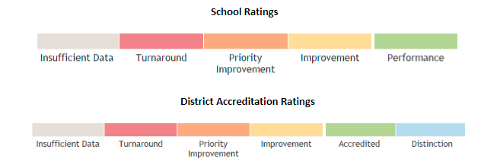
State Accountability System
The Education Accountability Act of 2009 (SB 09-163) as amended by HB18-1355 authorizes CDE to conduct an annual review of the performance of schools and districts and make recommendations to the State Board of Education.
Schools and districts that meet state expectations for student academic performance have increased autonomy
Schools and districts not meeting state expectations receive increased support and monitoring
Notes:
Topic: State Accountability System
As we mentioned in the timeline of relevant dates in Colorado’s charter history, the Education Accountability Act of 2009 authorized the CDE to—
conduct annual performance reviews of all public schools and districts, and;
make recommendations to the State board on (1) improvement plans for schools and (2) accreditation categories for districts.
Annual performance reviews are of charters across the state, those schools identified as in need of turnaround or priority improvement are subject to additional state supports and monitoring.
While some districts have their own system to monitor schools’ academic performance, most districts use the state’s accountability system in their authorizing work.

Slide 34
Releasing Schools to CSI
C.R.S. § 22-30.5-504
CSI may authorize schools if their district has not retained exclusive authority to authorize or if the district board gives permission to the applicant.
Why give permission?
Lack of capacity at district level for support & monitoring
Operational challenges (facilities, transportation, etc.)
Financial incentives
Local priorities and complex situations
Notes:
Topic: Releasing to CSI
As we mentioned before, in addition to district authorizers, the Charter School Institute is also an authorizing entity.
To this end, schools may (1) apply to CSI initially if their district has not retained exclusive chartering authority or (2) release a school to CSI during the application stage or potentially after the school is already open.
A district may give CSI permission to authorize a school located physically in their district due to a lack of capacity at the district level, other operational challenges, or due to a financial incentive as well.
(Turn over to Kelly)

Slide 35
What do you now know about charter law in Colorado?
True or False?
There is a cap on the number of charter schools allowed to open in the state of Colorado.
Districts never allow a charter applicant to apply to CSI when they have exclusive chartering authority.
Charter schools in Colorado are funded in the same manner as traditional public schools.
Notes:
Let’s review our quiz from the top!
1 – False – Although in the original law there was a cap, today there is no cap on the number of charter schools allowed to open in the state.
2 – False – A district may release a school to apply to CSI even when they retain ECA.
3 – (partially) False – Charter schools receive funding based on per pupil funding, but may not receive the same amount of funding if mill levy funds are not shared.

Slide 36
Questions? Reactions? Ideas?
Notes:
Discuss questions or reactions
Next – Send to 10mn break

Slide 37
BREAK
Notes:
Kelly to send participants to 10-minute break

