Slide 1
Annual Report
Colorado Authorizer Bootcamp
Notes:
Welcome and overview

Slide 2
Agenda
Purpose and audience for the Annual Report
Statutory basis for the Annual Report
CACSA Annual Report Template
Examining an Annual Report
Notes:
Discuss agenda

Slide 3
Objectives
Authorizers will understand the purpose and statutory requirements for an annual report.
Authorizers will understand how to use the CACSA Annual Report Template.
Notes:
Review objectives

Slide 4
What is the purpose of an annual report?
Notes:
We’ve already looked at multiple ways authorizers monitor the schools they oversee to ensure they comply with the law and looked at how to conduct an in-person site visit as well. Today we are going to look at how authorizers may take some of this data collected through monitoring and site visits and create an annual report.
Why do you think this is an important part of authorizing? What is the purpose of an annual report?
(Post in chat OR ask folks to share whole group and read out answers)

Slide 5
What is the purpose of an annual report?
Evaluate
Evaluate the charter school’s compliance and performance standards which are linked to the Colorado Statutes and/or Model Contract.
Support
Provide feedback, support school improvement, and inform interventions for schools.
Inform
Inform high-stakes decisions such as renewal.
Communicate
Share information about the school’s performance with the school and the public.
Notes:
An annual report serves multiple purposes.
First – It is used to evaluate a school’s performance and to ensure the school complies with all Colorado law and federal law.
An annual report is also a tool used to support schools, not just call out areas they need to improve on. An authorizers’ role is to support schools, provide feedback on areas of growth, and utilize interventions early on before a school is on the path for closure.
An annual report also helps gather information and document findings in a formal way that can then be used to inform high-stakes decisions, such as renewal or other high-stakes reviews.
Finally, an annual report can be used to communicate to the community and the public at large how the school is performing so that families have a clear picture of the school’s performance.

Slide 6
Who is the audience for the Annual Report?
Community Stakeholders
District School Board
Charter School Board
Families
Notes:
An annual report is created to give an overview of the performance of the school, but who is the audience for this report?
An annual report is intended to inform community stakeholders, the district board, the charter school board, and parents and families. It is a document that should be digestible and easy to understand so that all these audience members can gain an understanding of how the school is doing.
(CHAT: Are there any other audience members that may benefit from the annual report of a school?)

Slide 7
Statutory Basis for Annual Report
Statutory Requirements: C.R.S. § 22-30.5-110
During the term of a charter, the school district shall annually review the charter school's performance. At a minimum, the review includes the charter school's progress in meeting the objectives identified in the plan the charter school is required to implement pursuant to section 22-11-210 and the results of the charter school's most recent annual financial audit.
The school district shall provide written feedback from the review and include the results of the charter school's annual review in the body of evidence that informs renewal.
Notes:
And finally, let's talk about the statutory requirements behind an annual report.
Colorado Charter Law specifically states that during the term of a school's charter, it is the authorizer's responsibility to conduct an annual review of the school's performance.
This annual review must include reviewing the school's progress in meeting the goals and objectives they set out to meet in their contract as well as looking at the financial performance of the school.
Law also states that the school must be provided with feedback from this annual review that show the results from the review and the evidence the authorizer used to make these decisions. These annual reports should be used in renewal decisions as well.

Slide 8
CACSA’s Annual Report Template
Notes:
To help support this process, CACSA has developed an annual report template for authorizers to use for all schools they authorize.
The template created by CACSA meets statutory requirements and includes areas that are customizable to meet the needs of the district. The template is an excel file that includes a tab where users can paste data that will feed into the template. Within this session we will focus on this annual report template and practice using it.

Slide 9
What is the scope of CACSA’s Annual Report Template?
Notes:
CACSA's Annual Report includes a suite of materials that communicates the charter school’s performance academically, financially, operationally and ensures the school is compliant with statute and their contract. Indicators are used in each area that are pulled from what is required in statute.
Under Academic performance, users can input state data or district data
The Board Governance section is focused on indicators related to what is required in law for charter boards
Under Legal and contractual compliance, there are subsections that include reporting compliance, required programming, school environment and discipline, special student programming and compliance, as well as student enrollment.
Finally, financial performance includes looking at near term measures, financial stability of the school, and a review of audit performance.
The template does not summarize data for each of these four domains, but instead gives the authorizer the ability to decide how to weight and value the elements contained in each domain.
Alex - is there anything else you want to add here?

Slide 10
What data can authorizers use to populate their Annual Report?
State Accountability Reports – SPF
District-Specific Performance Frameworks
Assessment Data and Reports
Student Information Systems
Financial Audits
Board Meeting Agendas/Notes
Notes:
The data needed for the annual report may be drawn from a variety of sources. For many of the academic indicators, data can be pulled from the school's performance framework given yearly by CDE. The school's SPF is a main source of data to use academic data. Some districts may have district-specific performance frameworks that can be used in the academic section as well. Other assessment data and reports from the school level may be used as well.
For other sections outside of the academic indicators, authorizers may pull data from student information systems used in the district and from financial audits in order to evaluate the financial performance indicators.
(CHAT: Are there other places where data may be pulled from?)
There may be different sources of data you use depending on your district, if you conduct annual site visits, or if you conduct other compliance checks on the schools you sponsor.

Slide 11
Additional Qualitative Data
Given the impact of COVID-19, how could you collect qualitative data in the following categories?
Overall Performance
Academic Performance
Board Governance
Legal and Contractual Compliance
Financial Performance
Notes:
Whole Group Discussion: Given the impact of COVID-19, how could you collect qualitative data in the following categories?
-Overall Performance
-Academic Performance
-Board Governance
-Legal and Contractual Compliance
-Financial Performance

Slide 12
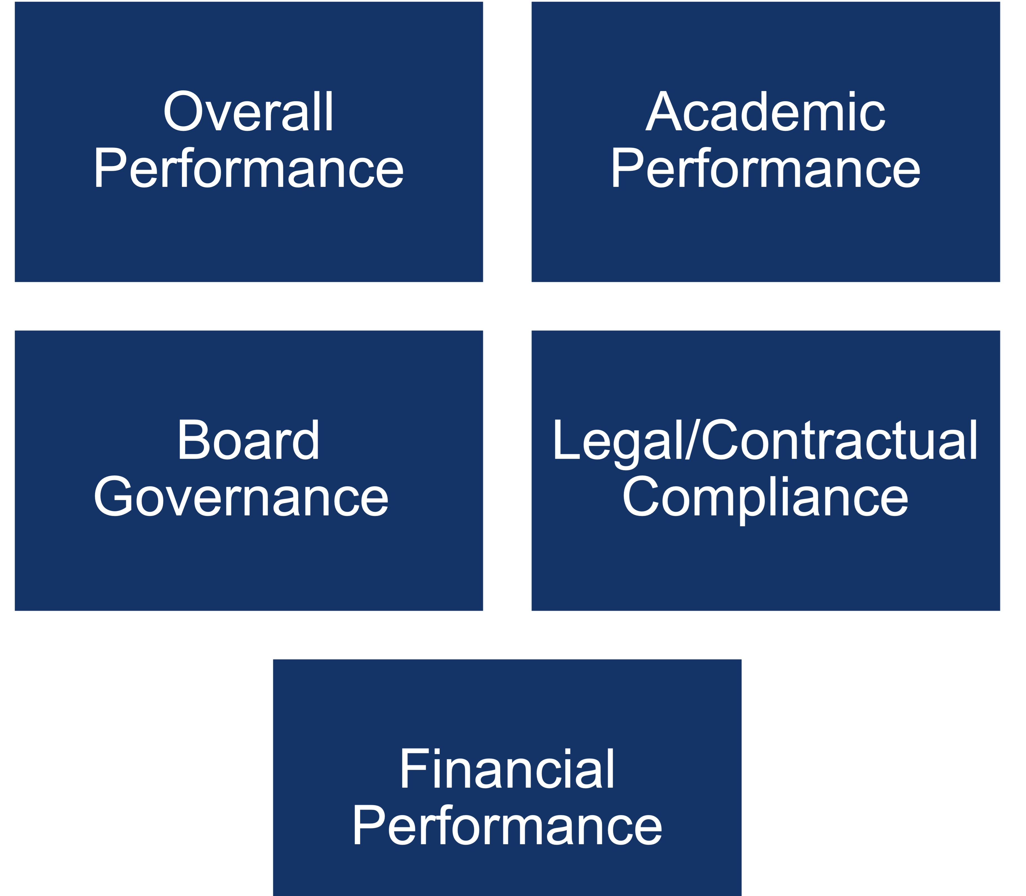
CACSA’s Annual Report Template
Components of the Report:
Other Factors Considered:
Enrollment percentages of special populations
Data for 3-year period
Room for district specific measures
Notes:
The annual report has four main components within it including the academic performance, board governance, legal & contractual compliance, and financial performance. All four of these categories feed into the overall performance rating of the school, which is given a score overall.
Each section is rated over the last three years of the school's life. The report also includes areas to fill in the school's information, including enrollment percentages for special populations within the school.

Slide 13
Let’s Take a Look
Was this school determined to be in good standing overall in 2020-21?
What is the accreditation status rating from CDE in 2019-2020?
What is an area where the school exceeded expectations on their annual report?
What questions might you ask if a school is not meeting their enrollment targets?
Based on the school’s annual report, do you believe any issues should be discussed with the school leader and/or board?
Notes:
Breakout Room Discussions
(10 minutes)
Sample Annual Report: https://coauthorizers.org/resource/cacsa-annual-report-mock-up-emphasizing-academic-performance/
Activity: Provide participants with an example annual report and guide discussion:
Was this school determined to be in good standing overall in 2020-21?
Answer: Yes
What is the accreditation status from CDE in 2019-2020?
Answer: Partially Meets
What is an area where the school exceeded expectations on their annual report?
Answer: Financial Liquidity in 2020-21
What questions might you ask if a school is not meeting their enrollment targets?
Potential Answers: Impact of COVID on enrollment, recruitment efforts made, etc.
Based on the school’s annual report, do you believe any issues should be discussed with the school leader and/or board?
Potential Answers: Dig deeper into board governance in 2020-21, specifically into training for new members

Slide 14
How will annual reports support you in your work as an authorizer?
Notes:
Discussion: How will annual reports support you in your work as an authorizer?
(Chat and discuss)

Slide 15
Questions? Reactions? Ideas?
Notes:
Discuss questions or reactions

Slide 16
BREAK
See you soon!
Notes:
(10-minute break)

