Slide 1
Decision Making
Colorado Authorizer Bootcamp
Notes:
*38-minute session
1:23-2pm
Welcome and overview

Slide 2
Agenda
Application Review Timeline
Application Submission
Standard Charter Application Review Rubric
Approval, Denial, Withdrawal, and Appeals
Notes:
Discuss agenda
Now that we have set the stage for the application process and the review process, today we will dive into the decision-making process. We will start by looking back at the timeline laid out in statute for the application process, talk about some tips for application receival, and spend the majority of our time focusing on the standard charter application review rubric that is used to score applications. Finally, we will talk about details around approval, denial, and the appeals process.

Slide 3
Bootcamp Overview
Contract Negotiation & Finalization
Annual Report & Site Visits
Review Process
1
1
2
3
4
5
6
7
Application Stage
Decision Making
Ongoing Monitoring
Renewal Process
You are here
Notes:
We have moved down our roadmap more and are now in the decision-making process. As a reminder, we will move from here to talk next about the contracting process and later move into topics such as monitoring, annual reports, and the renewal process.

Slide 4
Objectives
Authorizers will begin to understand statutory guidelines for the review process for charter school applications.
Authorizers will become familiar with the standard application rubric for charter applicants.
Authorizers will begin to understand the process for application approval, denial, withdrawal, and the appeals process.
Notes:
Review objectives

Slide 5
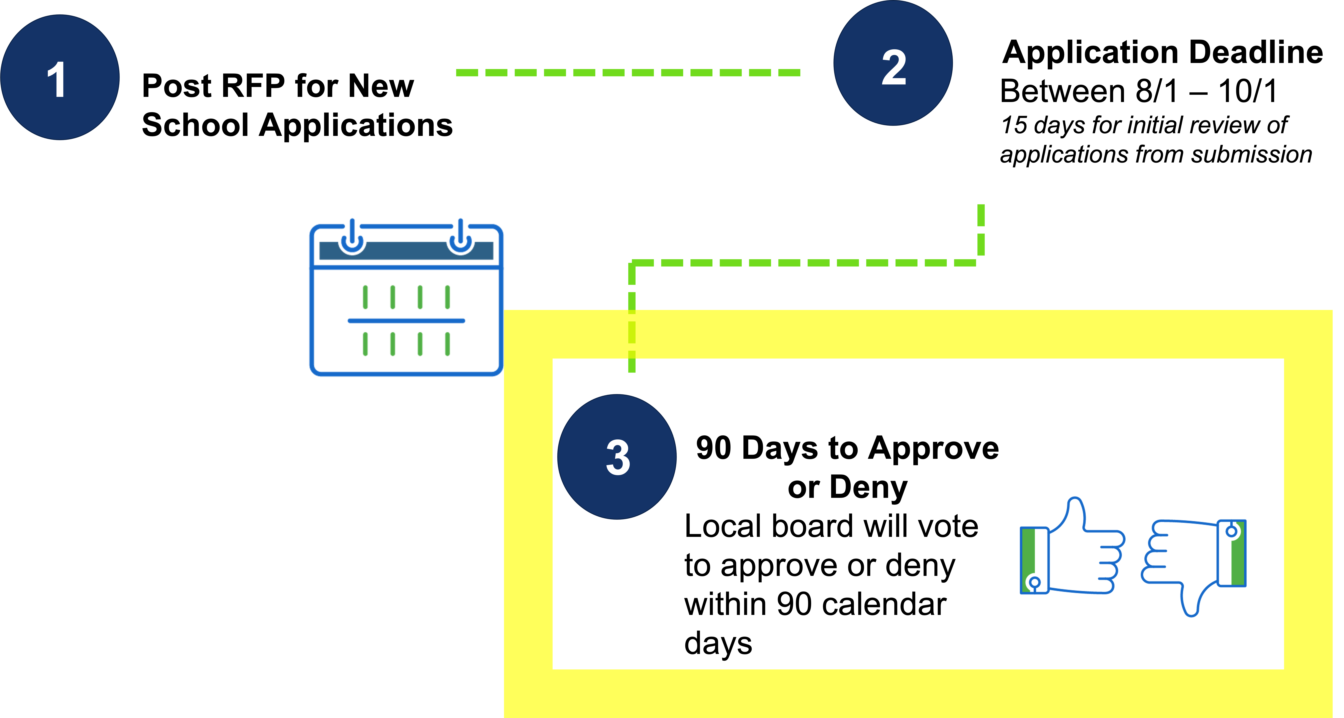
Application Review Timeline
F.S. §1002.33(6)
Notes:
We’ve discussed this timeline before but wanted to show once again that we are now focusing specifically on the decision-making process including how to score applications and take all aspects of the review process into account to make a recommendation to the district board regarding approval or denial.

Slide 6
CACSA Application Rubric
Overall Evaluation Factors
Comprehensiveness - Proposal has all essential pieces to support school’s plan
Support – Statements are backed by data, citations, or expert testimony
Mission Alignment – Plan works together toward same purpose
Cohesion – Pieces of plan are integrated together
Notes:
After applications are submitted, we know they are reviewed by a mix of internal and external reviewers. Review teams can utilize the standard application rubric to evaluate written applications.
This rubric is based on the standard application, with all of the same sections of the application listed with the addition of specific evaluation criteria. Reviewers will read each section of the application and score it, identifying the overall rating as well as the strengths and weaknesses of that section.
The overall evaluation factors reviewers should be looking for include comprehensiveness, support, mission alignment and cohesion.

Slide 7
CACSA Application Rubric (1)
Rating System:
Application is not a 4-point scale and no “total score” is given.
Each section reviewers also list:
Strengths
Concerns and Key Questions
Interview Notes (strengths, concerns, key questions)
Notes:
Each section of the application is scored as fully developed, mostly developed partially developed, and not developed.
The evaluation tool lists definitions for each of these scores and this rating system is consistent throughout every section of the application. This scale is not a 4-point scale.
Authorizers select which level of development each section of the application is written at but avoid using numbers. Using numbers leads to adding up and then seeing a total score, while some areas are deal breakers all on their own, and total numbers get used against authorizers in appeals, when one section is weaker or stronger than others.
Each section of the rubric also has space to list the strengths and areas of concern or additional questions. This is where reviewers will leave comments that identify supporting evidence for their rating.
In addition, there is space to include any notes form the capacity interview, also listing key questions, strengths and concerns from the responses gathered.
(Pause and ask for questions)

Slide 8
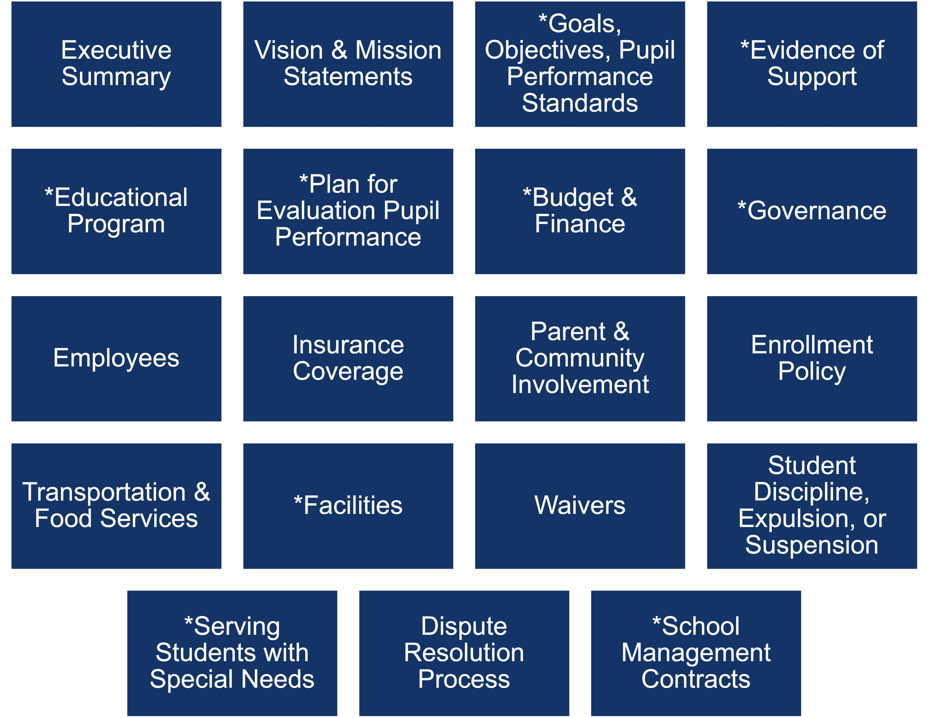
CACSA Application Rubric (2)
Each application section of the rubric is mandated by state statute.
*Considered essential components and often weighed heavier
Notes:
The application rubric includes all of the same components as the application, which is what is required in statute. For each section there is specific information listed for reviewers to look for and then make a scoring decision.
As a reminder, there is a 125-page limit for the narrative for applicants, which means reviewers are digging through a lot of content to score.
It is important that you have review teams with a mix of expertise of highly qualified individuals who will score each section of the application and leave detailed comments with evidence and a rationale for their scoring decisions.

Slide 9
CACSA Application Rubric: Evaluation Criteria
Notes:
As we stated, each section of the rubric lists specific evaluation criteria for reviewers to look for in the application. Here is an example of the one section of the rubric where the evaluation criteria are listed for the “Vision & Mission Statements” section.
The evaluation criteria listed varies in length for each section of the application and reviewers should use them to inform their decision-making process.

Slide 10
Let’s Practice
Step 1:
Read the section of the application
Step 2:
Score the section based on the CACSA Application Rubric
Step 3:
Discuss scores
Notes:
Let’s now take a look at an application together! In a moment we are going to go into small groups and look at part of a sample application. Within your groups you will have time to read the section of the application and score it against the evaluation rubric. Then you will discuss scores with one another and norm on how you came up with these scores.
Breakout Rooms
(20 minutes)
Sample Application: https://cdn.ymaws.com/coloradoleague.org/resource/collection/E9F22B40-1CD5-451B-8459-522447EF1644/Renaissance%20Goals%20section%202017.pdf
CACSA Rubric: https://coauthorizers.org/wp-content/uploads/2020/09/2020_CACSA_InterimStandardApplicationRubric.pdf
Jamboard link: https://jamboard.google.com/d/1Y3s6ePM7A7N-SZDc3SUMbhmZiPvrlI-4MgFEHxiGOTc/edit?usp=sharing
Facilitator:
7 minutes: Independently read and score application section
13 minutes: Discuss how each person scored
-What overall score did you give this applicant?
-What were the areas of strength in this section?
-What weaknesses did you identify?
-Were there substantive corrections needed?
Strengths:
Goals are SMART
Goals relate to state and authorizer performance indicators
Very comprehensive—they use a variety of measures of academic achievement and other outcomes
The goals expect growth (accelerate student achievement)
Additional goals are included that align to school’s mission and vision
Concerns:
Why did they indicate they may receive an improvement plan in their first year?
Do they need more interim goals-less than a year?
Key Questions:
I don’t see a plan for addressing performance gaps, but that could be in another section.
Also don’t see a plan for corrective actions if the school falls short of academic achievement goals.
How will this information be shared with the public and schools?
(Debrief whole group)

Slide 11
Parts of a Recommendation
Notes:
We’ve covered the multiple parts of the review process which will impact the decision your authorizing office makes when making a recommendation to approve or deny a charter application.
As a quick review, we now know that the DAC review, the community meeting, the application review as well as the capacity interview will all be taken into account when making a recommendation to approve or deny a charter application.
Due diligence is also necessary, especially for applicants that are part of EMOs and CMOs. Authorizers should ensure they are researching the background on networks themselves and not accepting everything they receive as the exhaustive list of material relating to the performance of a key actor like an EMO. (potential ask Kenlyn to share?)

Slide 12
Typical Pathway to Making a Recommendation
For some districts, the recommendation the authorizer office makes may only include the strengths and weaknesses of the application but not a yes or no recommendation on approval
Districts may handle the recommendation from the DAC differently, depending on district policy
Notes:
Once your authorizing office has made a decision to recommend approval or denial, this recommendation usually then goes to the Superintendent in your district who will review and make a final recommendation to the district board.
The district board then votes to approve or deny, which again must be done within the 90–day timeline in statute.

Slide 13
Application Approval
C.R.S. § 22-30.5-107
Application meets statutory requirements set forth in application process
School has demonstrated strengths
Any weaknesses could be addressed through contract terms or a sponsor determined remedy
Next steps
Review teams present recommendation to superintendent
District Board votes to approve or deny
Vote must occur within 90-day review window
Contract finalized within 90 days of vote of approval
Notes:
If an application meets all statutory requirements through the written application and capacity interview, an application can be approved.
This does not mean an application needs to be perfect – there may be identified weaknesses within the application that can be cured through the contract negotiation process.
If this is the case, the application may be approved, and this recommendation is presented to the superintendent. From there, the superintendent brings this decision to your school board who will vote and make a final decision.

Slide 14
Application Denial
C.R.S. § 22-30.5-108
Denial should be clearly tied to statutory requirements and statutory language used to outline denial reasons
Prepare denial with evidence of strong rationale, keeping in mind a potential appeal defense
Next Steps?
Recommend to superintendent - District Board vote and final decision
Provide documentation to applicant with specific reasons for denial based upon good cause
Provide documentation with the same reasons for denial to CDE within 15 days
Notes:
If reviewers determine that an application should not be recommended to be approved, ensure that the denial is clearly tied to statutory requirements.
Within the denial letter, this reference to statute should be included to ensure there is a strong rationale and evidence for denial. This evidence is important to have on hand in the event the applicant appeals the decision to the State Board of Education.
Once again, the review team will make their recommendation to the Superintendent, who will bring it to the District Board for a final vote.
Once the District Board has voted to deny, documentation must be provided to the applicant with good cause for denial, and this same evidence must be submitted to CDE within 15 days of the vote.

Slide 15
Application Withdrawal
Applicants may withdraw at any time.
If an application will likely be denied, the sponsor can encourage withdrawal to avoid a denial.
Benefits of Withdrawal for Applicant:
Provides opportunity for applicant to avoid denial before school board and public
Benefits of Withdrawal for Sponsor:
Eliminates preparing denial documents and potential appeal
May avoid politicization that often comes from denial with community and district board
Notes:
An applicant may withdraw their application during any point of the review process; however, an authorizer may also encourage an applicant to withdraw their application if they will likely be denied.
This encouragement can come in the form of a letter to the applicant, or through a more informal conversation.
Withdrawing their application provides the applicant an opportunity to avoid a public denial before the board and the community and may allow them additional time to strengthen their application and resubmit the following year.
This also helps to foster a relationship between the district and the applicant and would eliminate any possibility of an appeals process.

Slide 16
Appeals Process
C.R.S. § 22-30.5-108
60 Days to Act
30 Days to Submit
30 Days to Submit
Notes:
If an applicant does not withdraw an application and is denied, they have the right to appeal this decision to the State Board of Education within 30 days of the denial decision.
The State Board will then review the decision that was made by the local district and either uphold the denial or may find that the local board’s decision was contrary to the best interests of the community and will make a recommendation to reconsider the application.
If the decision is to reconsider the application, the local board then needs to reconsider its decision and hold a public vote of a final decision.
If this vote still denies the application, the applicant can go back to the state board for a final appeal. The decision made by the state board at this point is the final decision.

Slide 17
How to Avoid Appeals
Notes:
The appeals process is burdensome, messy, and often does not result in strengthening relationships with schools or the community.
In order to avoid the appeals process entirely, it is important to ensure that you have structured support in place for potential applicants so that the applications you receive are high quality.
It is also important to design and document your process for reviewing applications and stick to these plans and policies.
Finally, it is important to have open and honest conversations with applications who may not be ready to apply.

Slide 18
Questions? Reactions? Ideas?
Notes:
Discuss questions or reactions

Slide 19
Follow-up Professional Development Opportunities
Notes:
Opportunity to plug upcoming CACSA sessions.

Slide 20
Thank you!
Week 3:
Tuesday, November 16th
12pm-2pm

