Slide 1

Colorado Authorizer Bootcamp
Week 5
Notes:
Welcome and overview

Slide 2

Today’s Agenda
12:00 – 1:00 pm – Renewal Decisions
1:00 – 1:10 pm – BREAK
1:10– 2:00 pm – Intervention Protocols
Notes:
Discuss agenda for day

Slide 3



Bootcamp Norms
Remember to mute yourself
Utilize the chat for questions and comments
Respond to the survey
Notes:
Before we dive into Bootcamp, let’s go over some quick norms. By now I bet you’re all zoom experts, but as a reminder:
1- Remember to mute yourself when you’re not speaking
2 – Utilize the chat box for any questions or comments that come up during any presentation today. We will have time for questions at the end of every session, but as questions come up feel free to drop that in the chat. We will try our best to answer any and all questions during the presentation, but if we don’t get to them CACSA will be sure to note them.
3 – Please respond to the survey that we will be sending out at the end of each day of Bootcamp. Your feedback will help to ensure this Bootcamp is successfully and helps to improve your own practice in authorizing.

Slide 4




Bootcamp Engagement
We want you to be an active participant!
Chat Question
Poll Question
Group Discussion
Authorizer Example
Notes:
This Bootcamp is going to cover a lot of information, and we want you to be involved in every session as an active participant.
You’ll see these icons on slides where we have ways for you to engage, whether that is through a poll question, chat question, small group discussion in a breakout room, or by listening in to an established Colorado authorizer.
We encourage you to keep your cameras on and be an active participant in today’s sessions.

Slide 5
Renewal Decisions
Colorado Authorizer Bootcamp
Notes:
Welcome and overview of session
60-minute session
12pm-1pm MST

Slide 6
Agenda
Purpose of Renewal
Renewal Process Overview and Timeline
Body of Evidence and Renewal Application
Site Visits
Renewal Evaluation
Options Short of Nonrenewal
Board Recommendation
Notes:
Discuss agenda

Slide 7
Bootcamp Overview
Contract Negotiation & Finalization
Annual Report & Site Visits
Review Process
1
You are here
1
2
3
4
5
6
7
Application Stage
Decision Making
Ongoing Monitoring
Renewal Process
Notes:
Let’s start by revisiting this graphic to see where we are. We started the last session by discussing ongoing oversight and monitoring and are now going to move into the renewal process.

Slide 8

Objectives
Authorizers will understand the purpose of renewal.
Authorizers will understand the components of the renewal process.
Authorizers will understand the statutory requirements related to renewal.
Authorizers will understand renewal decision-making.
Notes:
Review objectives

Slide 9

In Practice: Interview with Experienced Authorizer
How many schools do you authorize?
On average, how many schools are up for renewal each year?
How do you communicate the renewal process to the schools?
How does the renewal process impact your relationship with the schools that you authorize?
How do you communicate areas of concern that don’t lead to nonrenewal?
Notes:
Interview w/ Experienced Authorizers: (10 minutes)
Matt Meyers – DPS (confirmed)
Jessica Walsh– CSI (confirmed)
How many schools do you authorize?
On average, how many schools are up for renewal each year?
How do you communicate the renewal process to the schools?
How does the renewal process impact your relationship with the schools that you authorize?
How do you communicate areas of concern that don’t lead to nonrenewal?

Slide 10




Purpose of Renewal
Ensure the school is complying with its charter and meeting the goals in its charter
Ensure the school is performing in the areas of academics, governance, legal and contractual compliance, and finance
Support schools in continuous improvement and addressing areas of need
Ensure the school is effectively serving all students
Notes:
Topic: Renewal Purpose
The renewal process is a time to review the school’s compliance with its charter and make sure it is effectively serving all students.
It’s also a time to identify and support schools in addressing areas of need.
Finally, the renewal process is a time for the authorizer to make evidence-based decisions about the school’s status—should it continue to operate for another 4+ years, does it need to address specific conditions, and therefore should be renewed for a shorter period?

Slide 11
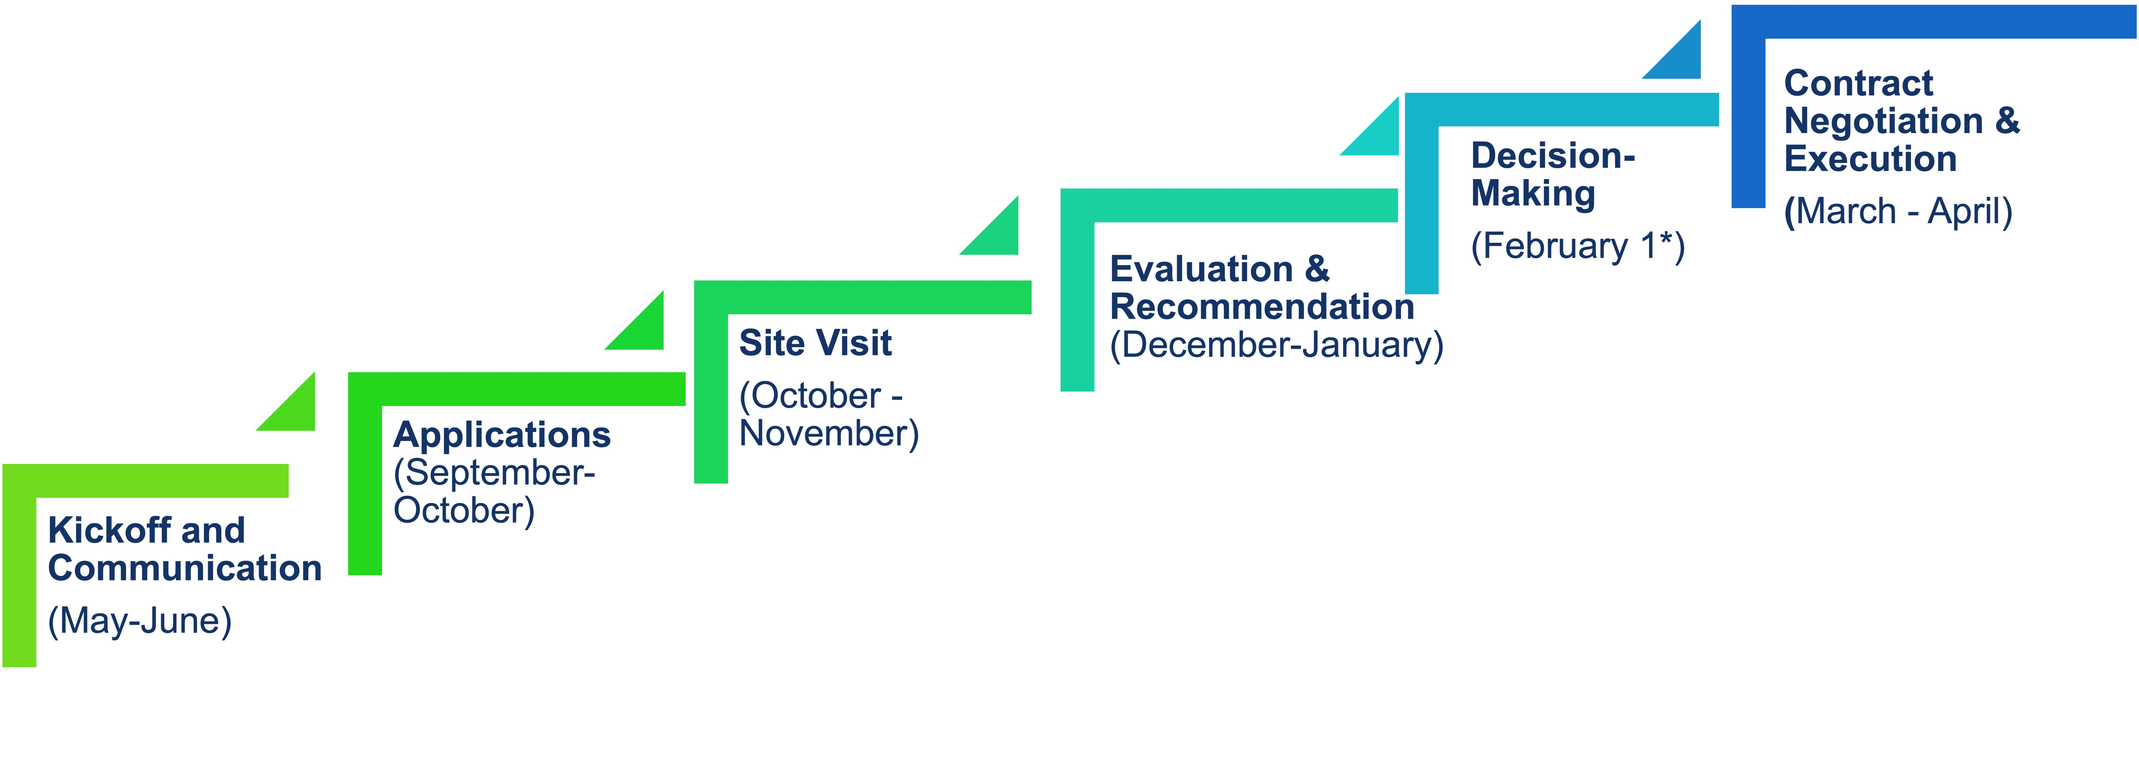
Renewal Process Overview and Timeline
*C.R.S. § 22-30.5-110
Notes:
Topic: Renewal Process Overview
This graphic illustrates the key components of the renewal process and related timeline.
These are the key steps in the renewal process. We will review them all during this presentation.
By law, renewal applications are due by December 1st of the year before the school’s charter expires and the District Board must vote on the renewal application by February 1. However, CACSA recommends having the renewal application due in September or October to provide plenty of time for evaluating the information.
Kick off call during May or June
Renewal application in September or October
Site visits in October or November
Evaluation & Recommendation in December and January
Board vote by February 1st
Contract Negotiation & Execution through March and April
(CHAT or Share Out: How does this timeline align (or not align) with the timeline for the application process? How might this impact your authorizing staff?)

Slide 12

Kick Off Meeting
Overview of Renewal Process
Schedule Regular Check-Ins
Schedule Site Visit
Q&A
Notes:
Topic: Kickoff Meeting
The renewal process should begin with a kickoff meeting between the authorizing staff, the governing board chair, and the school leader.
At the kickoff meeting, the authorizing staff should explain the renewal process and the expectations for the school, articulate the timeline, and explain what documents and data the school will need to provide.
At this meeting, the team should also schedule the renewal site visit and will provide a brief overview of what will occur on the day of the site visit. This meeting should provide an opportunity for the school leadership to ask questions about the renewal process and to ensure that all three parties are clear about expectations and timelines.
At the kickoff meeting, the authorizing staff should also schedule regular check-ins with the school leadership throughout the renewal process.

Slide 13
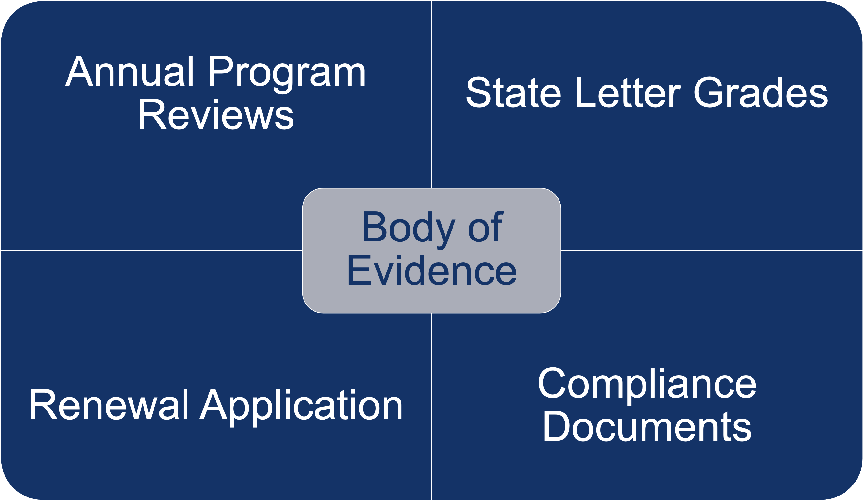
Body of Evidence
Notes:
Topic: Body of Evidence
The Body of Evidence is the information that an authorizer uses to assess school performance and inform the renewal decision.
The body of evidence typically includes annual reports, notices of concern or breach over the course of a contract, monitoring data and document submission, financial audits, and site visit data.
Other data that may be included in the body of evidence are the school’s Unified Improvement Plan and Accreditation Status.

Slide 14
Renewal Application Process (1)
Part 1. Renewal Reflection
Part 2. Required Body of Evidence Submissions
Notes:
Topic: Renewal Application Process
The renewal application provides the school with an opportunity to reflect on their progress (Part 1. Renewal Reflection) and submit relevant documents and data that authorizer staff will use to inform their renewal recommendation (Part 2. Required Body of Evidence).
CACSA has created a two-part template to accomplish these two purposes of reflection and submitting relevant data.

Slide 15
Renewal Application Process (2)
Part 1. Renewal Reflection
Academic Performance
Describe and reflect on the school’s mission and vision.
Describe and reflect on the school’s authorizer-determined, school-specific measures.
Is the school’s education program a success?
What changes, if any, does the school plan to make to their academic program?
Is the school effectively serving all students, including students with disabilities and English learners?
Notes:
Topic: Renewal Application, Part 1. Renewal Reflection
This is an example of renewal reflection questions on the school’s academic performance.
Other reflection question sections include Board Governance, Legal and Contractual Compliance, and Financial Performance.

Slide 16
Renewal Application Process (3)
Part 2. Examples of Required Body of Evidence Submissions
School Performance Framework and/or District Framework
School Calendar
Master Staff Schedule (including class times, teachers, content, and location)
Staff Roster
Curriculum Overview
Board Meeting Schedule
Board Roster
Strategic Plan
Board Handbook
Financial Policies and Procedures
Annual Independent Audit
Unaudited Financial Statements
Notes:
Here are some examples of the types of documents that an authorizer might want to collect as part of Part 2 of the application
(CHAT or Share Out: Are there any other examples of body of evidence submission you may ask for?)

Slide 17
Site Visit Activities
School Walk-Through: Walkthrough of school to observe school culture, facility, safety, learning environment.
Classroom Observations: Observations of instruction to observe fidelity to their model, best practices for instructing students with disabilities and English learners.
Document Review: Review documents such as IEP records, teacher credential documents, school safety plans, enrollment documents.
Interviews: Interview board members and school leaders to assess school policies and leadership practices.
Focus Groups: Meet with parents and teachers to assess school culture and instructional practices.
Notes:
Topic: Site Visit Activities
Here’s a quick recap of some of the important activities and types of information to collect during a site visit.

Slide 18
Renewal Evaluation (1)
Standards for Charter Schools and Charter School Authorizers, 1CCR § 301-88, 3.06
Standard for Renewal
Renewal decisions are based on a “thorough analyses of a comprehensive body of objective evidence defined by the performance framework in the charter contract.”
Academic achievement “is the most important factor to consider when determining whether to revoke or not renew a charter.”
Notes:
Topic: Renewal Evaluations—Renewal Standard
According to Colorado’s Standards for Charter Schools and Charter School Authorizers, adopted by regulation, these are the statutory bases on which to make a renewal decision.
Renewal decisions must be based on a comprehensive and objective body of evidence.
We’ve talked about the body of evidence earlier—this will include the renewal application, annual reviews, site visit findings, and compliance documents. The regulations also require a performance framework in the charter contract to inform the renewal decision.
Regulations also require that academic achievement be the most important factor when making a renewal decision. Given this, academic performance is not the only reason for nonrenewal, as schools can be closed exclusively for other issues or areas of noncompliance.

Slide 19
Renewal Evaluation (2)
C.R.S. § 22-30.5-110(3)(a)-(d)
Standard for Renewal
Committed a material violation of any of the conditions, standards, or procedures set forth in the charter contract;
Failed to meet or make adequate progress toward achievement of the goals, objectives, content standards, pupil performance standards, targets for the measures used to determine the levels of attainment of the performance indicators, applicable federal requirements, or other terms identified in the charter contract;
Failed to meet generally accepted standards of fiscal management;
Violated any provision of law from which the charter school was not specifically exempted; or
Required to implement a turnaround plan for a second consecutive school year and does not have evidence of sufficient improvement, or a required to implement a turnaround plan for a third consecutive year.
Notes:
Topic: Renewal Evaluations
These are the reasons for nonrenewal.
Chat an example of “a material violation of any of the conditions, standards, or procedures set forth in the charter contract.”
(CHAT or Share Out: What might be an example of “a material violation of any of the conditions, standards, or procedures set forth in the charter contract”?)

Slide 20
Renewal Evaluation (3)
Body of Evidence
Use the body of evidence to assess:
Academic Performance: Is the school’s education program a success?
Board Governance: Is the school operating and governed effectively?
Legal and Contractual Compliance: How has the school ensured compliance with federal law, state law, and the school’s charter contract?
Financial Performance: Is the school financially solvent/viable?
Notes:
Topic: Renewal Evaluations
Evaluation establishes a basis for whether charter can be renewed
Basis for authorizer staff report/recommendation for district board
Questions that align with CACSA’s annual report evaluation components
Authorizers should identify measures with each component that inform the renewal recommendation

Slide 21
Renewal Evaluation Considerations (1)
COVID-19 Impact
Schools have had disruption to their educational models.
Students have had inconsistent learning experiences and access to technology.
Authorizers lack state assessment data for 2019-20, and data for 2020-21 may be incomplete.
Other impacts such as social-emotional impacts, impacts to school culture and staffing, etc.
Notes:
Topic: Renewal Evaluations—COVID-19 Impact
As a result of COVID-19, schools have modified their instructional models in real-time to provide students with technology for remote learning, and to support students and families with the emotional and physical health challenges during this time. Students have also had inconsistent learning experiences and access to technology during remote instruction, even within the same school.
Authorizers will lack state assessment data for the 2019-20 school year and there are some challenges in considering assessment data for the 2020-21 school year. Authorizers may want to review and consider which students participated in state tests during the 2020-21 school year to understand how representative they are of the total population of students.
There are additional effects as well such as impacts to student and staff’s social-emotional well-being, school culture, staffing, etc.

Slide 22
Renewal Evaluation Considerations (2)
Responding to COVID-19 Impact
Expand evidence/data schools can provide to demonstrate performance trajectory (i.e., formative and summative assessments).
Work with schools to agree on academic measures to assess performance in 2019-20 and 2020-21.
Understand how representative 2020-21 assessment data is of the student population.
Use annual reviews and site visits to inform renewal decisions moving forward.
Notes:
Topic: Renewal Evaluations—COVID-19 Impact
Given these ongoing challenges, CACSA recommends that authorizers consider these unique circumstances and expand the body of evidence to assess charter schools’ progress in meeting goals and performance expectations when evaluating schools’ performance during the 2019-20 and 2020-21 school years and possibly beyond.
To address these gaps and challenges with state standardized assessments, authorizers may want to use additional academic data to assess performance during the renewal process. One approach authorizers could take is to provide a list of the types of data schools can use to provide evidence of academic performance in the 2019-20 and 2020-21 school year and include specific examples.
This data could be used to support the school’s performance trajectory and would complement the state assessment data. Authorizers’ lists may include formative and summative assessments, grades, and course completion for high school students. There may be other types of data authorizing staff would want to consider as well.
Another approach is to provide guidance about the characteristics of assessments that should be used. For example, assessments should assess grade-level standards and represent the learning of a significant portion of students.
Authorizers may also want to consider requiring schools to only use assessments used in prior years to demonstrate performance trends. Lastly, authorizers are encouraged to work with each school to agree on the academic measures for assessing performance in the 2019-20 and 2020-21 school years, based on the authorizer’s guidance.

Slide 23

Discussion
How has COVID impacted your renewal process?
How have you addressed any obstacles that have come up?
What outstanding questions do you have?
Notes:
Whole Group Discussion (10 minutes)
How has COVID impacted your renewal process?
How have you addressed any obstacles that have come up?
What outstanding questions do you have?

Slide 24
Renewal Recommendation
Developing Report/Recommendations
Authorizer staff reviews body of evidence and create report/recommendations based on body of evidence.
Provide school opportunity to review/provide feedback.
Finalize evaluation to support district board’s decision-making.
Notes:
Statute requires that authorizing staff submit a written report summarizing their renewal evaluation. Some authorizing staff include a recommendation to renew or nonrenew the school as well.
Authorizers vary in terms of what type of report and accompanying data they provide to the district board.
Authorizers should consider providing a summary document as well as a more detailed summary analysis of each of the evaluation components, particularly any issues with serving specific student populations.
A best practice is to provide the school an opportunity to provide feedback on the report before finalizing.

Slide 25
Options Short of Nonrenewal (1)
Continuous Improvement and Conditions
A primary purpose of the renewal process is to support schools in continuous improvement.
The data collected as part of the body of evidence identifies strengths and areas for growth.
Authorizers may want to include conditions that schools must address as part of the renewal contract.
Notes:
One of the primary purposes of the annual review and renewal process is to support schools in continuous reflection and improvement.
All of the data collected as part of the body of evidence can be used to support schools and authorizers in engaging in a process of continuous improvement and reflection.
In addition, authorizers can use the unified improvement planning (UIP) process to support school improvement.
All schools are required to develop an annual improvement plan using the UIP template developed by CDE.
This document can be the foundation for an ongoing conversation about the school’s strengths and areas for improvement and the strategies the school intends to implement to address the areas for improvement.
One way to codify improvement strategies that are critical to improving school performance is to incorporate them into the renewal contract as conditions.
Colorado law supports renewing charter contracts with mutually agreed-upon renewal contract conditions.
These conditions allow an authorizer to renew a school that demonstrates potential to improve but isn’t meeting standards at the time of renewal.

Slide 26
Options Short of Nonrenewal (2)
Differential Contract Lengths
Authorizers can use shorter contract lengths for schools that don’t warrant a full, five-year renewal.
These schools may not justify a non-renewal, but may need another review sooner than five years.
Another option is to combine conditions with contract lengths.
Any conditions in contracts are subject to appeal, therefore strong evidence and rationale should be provided.
Notes:
Another option is to use different contract lengths.
The benefit of differential contract lengths is that the length of a contract can vary based on the performance of a school. Therefore, in cases where a school’s performance doesn’t merit a full-length renewal, but the school has potential for improvement, the authorizing staff may recommend a two or three-year renewal contract.
A two or three-year contract provides for another in-depth evaluation on a shorter timeline and may also incorporate conditions, as discussed in the prior section.
It’s important to note that any conditions within a contract are subject to appeal to the state board, so a strong body of evidence and rationale must be provided to the school in advance. The reasons for any conditions or different contract term lengths should be clear and coherent, rather than seeming like an add on to a process. It’s important for districts to proactively document any concerns that come up during the annual report process or other times when intervention is utilized to have as evidence during the renewal process.

Slide 27
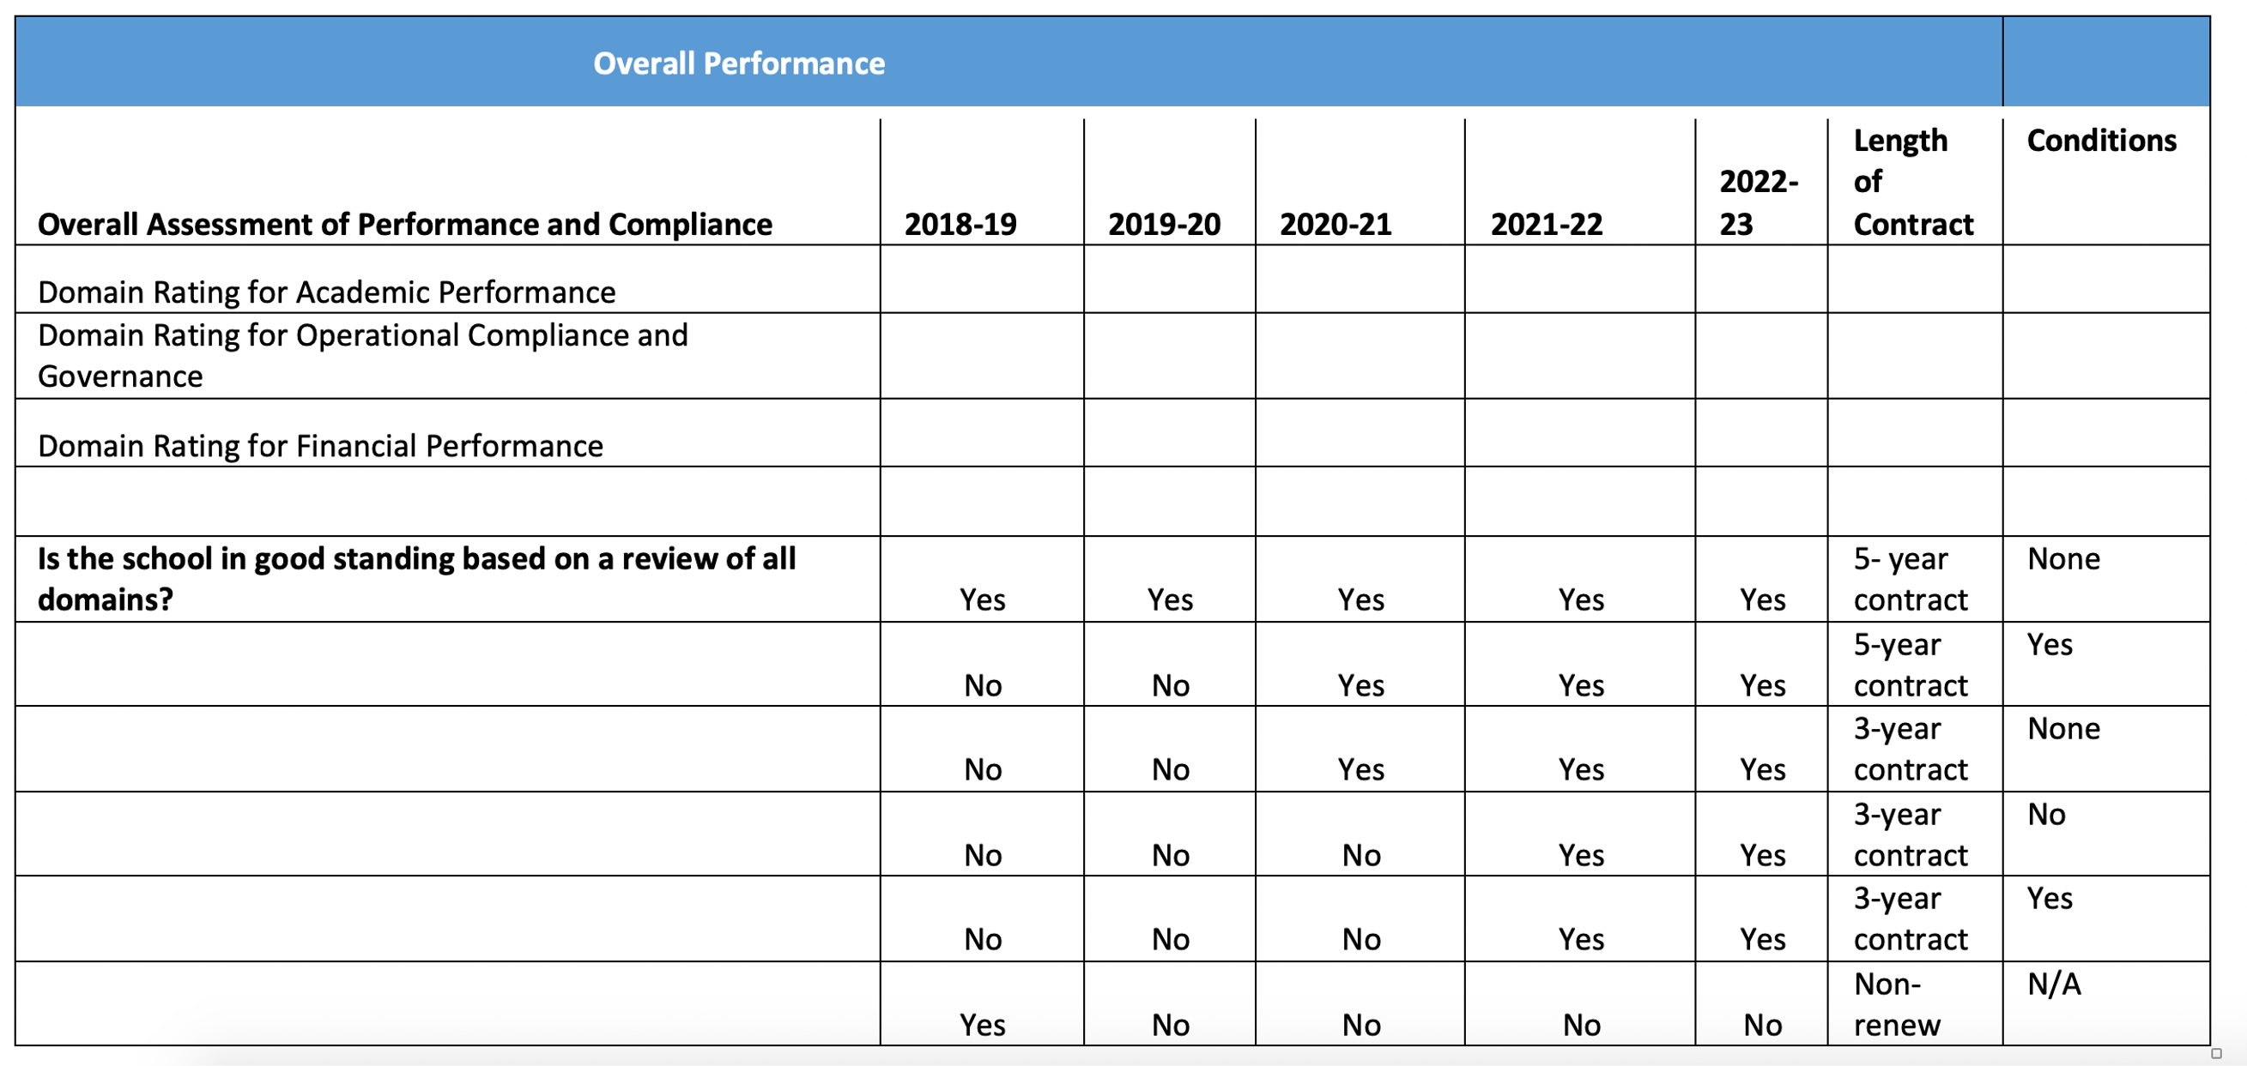
Bringing it All Together: Renewal Contract Guidance
Notes:
Topic: Renewal Contract Rubric/Guidance
This rubric provides one example of how authorizing staff might think about contract terms and conditions. For example, a school in good standing in all domains for all five years would clearly get a 5-year contract with no conditions, while a school that has been in good standing in all domains for only three years, might get specific conditions based on the reasons they were not in good standing.
Professional judgement is a critical ingredient for making these decisions, which is why the rubric offers different contract options for schools with the same ratings.
Authorizing staff should have an in-depth understanding of the challenges facing each school by reviewing the body of evidence and using these data to inform the contract terms and conditions.
For example, in the rubric, there may be a school that was not in good standing based on a review of all domains for three years in a row, but the non-compliance was related to poor board performance and there’s been a new board in place for two years. In this case an authorizer may decide that conditions are no longer necessary and a three-year contract with no conditions is warranted.

Slide 28
Board Recommendation
Grounded in the body of evidence supplied during the renewal.
The Board deliberates on the renewal decision in a public meeting.
Made by resolution by February 1st of the year in which the school’s contract expires.
If the Board decides not to renew the charter, it must state its reasons for doing so.
In the event of an appeal, the board should be advised by legal counsel of grounds for nonrenewal.
Notes:
Topic: Board Renewal Vote
The Board’s renewal determinations must be (1) grounded in the body of evidence supplied during the renewal and (2) made by resolution by February 1st of the year in which the school’s contract expires. So, the body of evidence informs the report that the authorizing staff provides to the Board.
The Board will then deliberate on the renewal decision in a public meeting and decide.
If the Board decides not to renew the charter, it must state its reasons for doing so.

Slide 29

Questions? Reactions? Ideas?
Notes:
Discuss questions or reactions

Slide 30
BREAK
See you soon!

